Slide 1
APG Senior Leadership Cohort Program 2016
The Introvert Advantage – How to Thrive in an Extrovert World
Troy A. Alexander

Slide 2
The Introvert Advantage Book Review
The Introvert Advantage – How to Thrive in an Extrovert World
Author: Marti Olsen Laney, Psy. D.
Book Focus: Introversion; Interpersonal relations
Workman Publishing/New York
ISBN 0-7611-2369-5

Slide 3
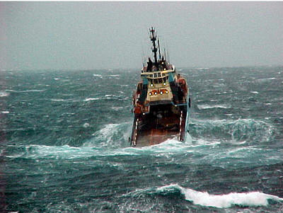
The Introvert Advantage Book Review
A Fish Out of Water
What’s an Innie? Are you one?
Why are Introverts an Optical Illusion?
The Emerging Brainscape: Born to be introverted?
Navigating the Extroverted Waters
Relationships: Face the music and dance
Parenting: Are they up from their nap already?
Socializing: Party Pooper of Pooped from the Party?
Working: Hazards from 9 to 5
Creating the “Just Right” Life
Three P’s: Personal Pacing, Priorities, and Parameters
Nurture your Nature
Extroverting: Shine your light into the World

Slide 4
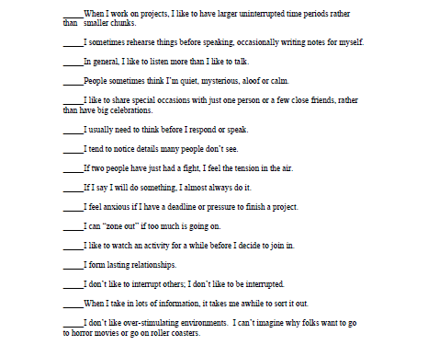
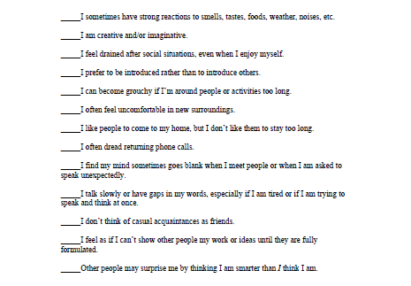
Introversion Self-Assessment
Greater than 20 True – Introverted Less than 10 True – Extroverted

Slide 5
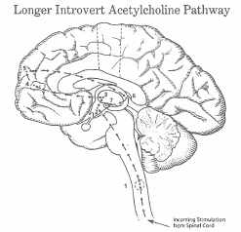
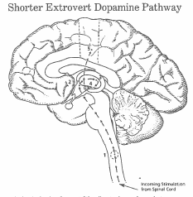
Born to be Introverted – Brain Chemistry
Throttle-Down
Parasympathetic System
Reticular Activating System
Hypothalamus
Anterior Thalamus
Broca’s Area
Frontal Lobe
Hippocampus
Amygdala
Full-Throttle
Sympathetic System
Reticular Activating System
Hypothalamus
Posterior Thalamus
Amygdala
Temporal and Motor Area
Extroverts are linked with the dopamine/adrenaline, energy-spending, sympathetic nervous system, introverts are connected with the acytylcholine, energy-conserviing, parasympathetic nervous system.
Two primary systems, the Throttle-Down (parasympathetic) and Full-Throttle (sympathetic), are the basic foundations of introverted and extroverted temperaments.
Introversion is a temperament not a pathology!

Slide 6
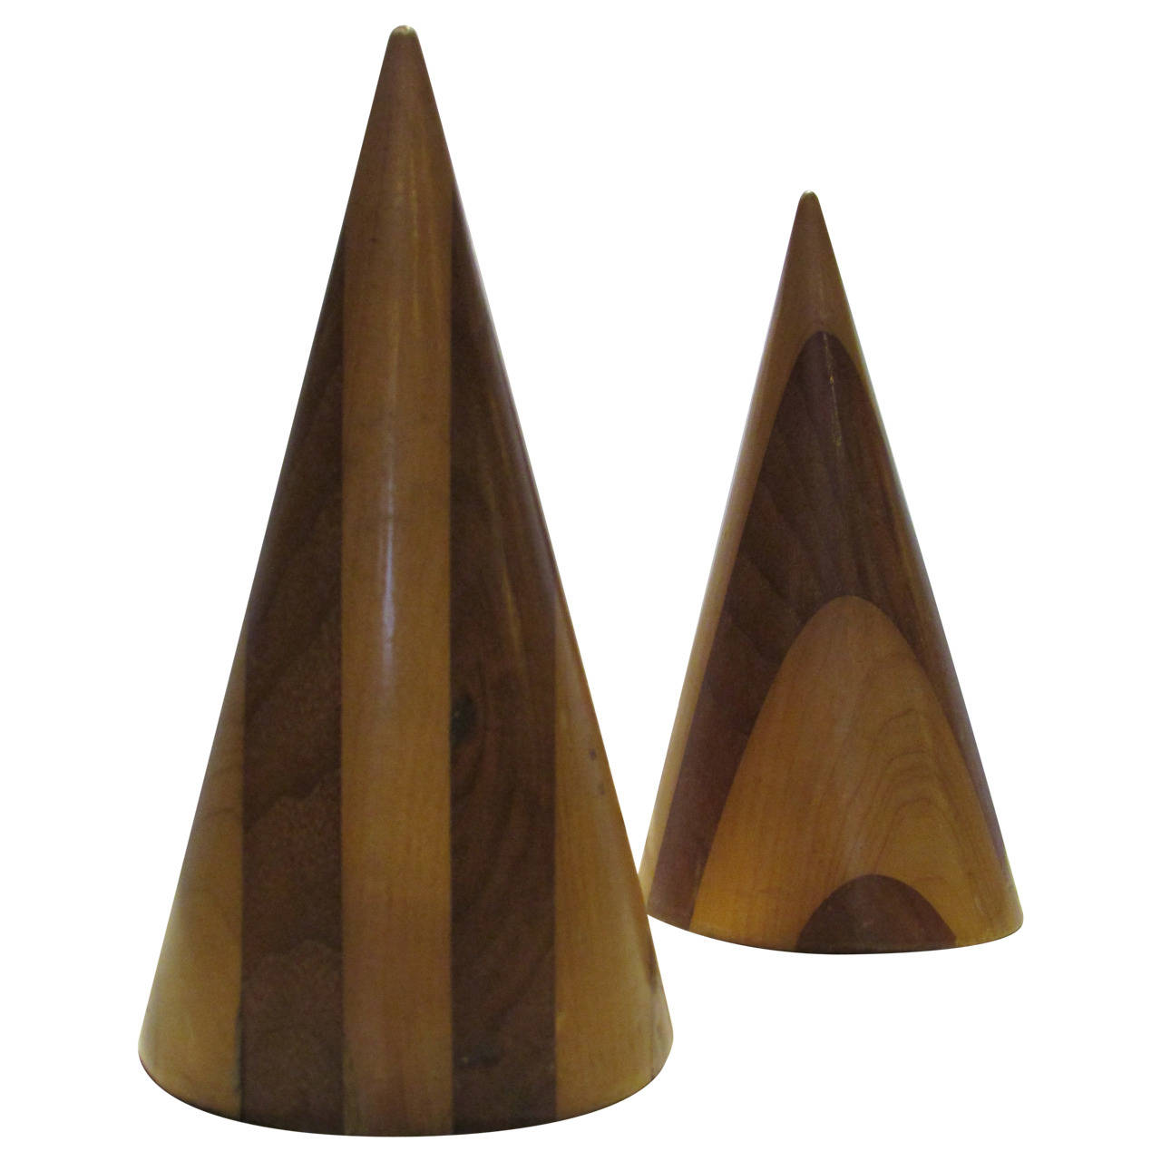
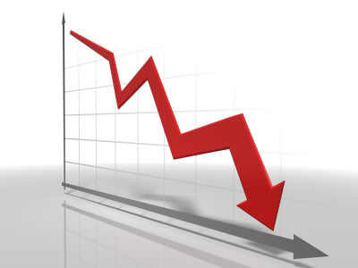
A tale of two worlds
Population
Energy Management
Idea Cultivation
Social Engagement/Interaction
INTROVERTS
EXTROVERTS
Introvert and Extrovert manifestations are very different

Slide 7
Key Messages from this Book
Introverts and Extroverts have different primary systems responsible for the differences in their temperaments
Introverts must plan ahead to manage their energy levels to be effective
Most social paradigms and expectations have been developed by extraverts; introverts can be effective in this area but must strategize and plan before hand
Introverts should be comfortable with themselves – their temperaments are set at birth

Slide 8
Quotes from the book
Introversion is a temperament not a pathology!
Extroverts are like lighthouses, focusing their beacon outward toward the world. Introverts are more like lanterns, radiating a glow inside themselves.
Plan what you can do out of what you must do, and then set your pace.
Spend your energy wisely.
Confidence rests on an inner pledge. It’s an agreement you make with yourself to learn or do whatever you need to do in order to attain your goals.
Extroverting is a gas guzzler.

Slide 9
What This Book Meant To Me
The book does a great job of explaining the foundations of introversion vs extroversion.
The book provides really good strategies and approaches for interacting with extroverts.
The book would be made better if it spent some time talking about how introverts can influence extroverts
I wish that I would have read this book long ago. I strongly recommend to both introverts and extroverts.

