Slide 1
APG Senior Leadership Cohort Program 2014
How Did That Happen
By Roger Connors and Tom Smith
Cesar Saenz

Slide 2
Leadership Book Review
How Did That Happen
Author: Roger Connor and Tom Smith

Slide 3
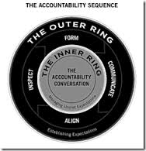
The Accountability Sequence
Form ~ Ensure your key expectations are Framable, Obtainable, Repeatable and measurable
Communicate ~ You need people to use their hearts and minds, not just hands and feet. Thus, you need to engage in a 2-way Why-What-When discussion
Align ~ Complyment = hands and feet; Complete Alignment = hearts and minds. Identify everyone in the expectations chain to ensure everyone is aligned.
Inspect ~ This experience doesn’t have to be negative. Reinforce progress vice harping on shortfalls, provide needed support vice just “testing people”. Promote learning by capturing best practices for future success.

Slide 4
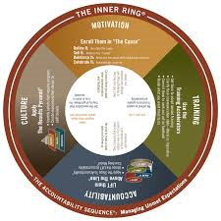
The Inner Ring
Motivation ~ Most effective to start here. Define it, Sell it, Advocate it, and Celebrate it.
Training~ Assess competency and watch out for filters such as listening and communication styles (literal vs. Figurative). When all else fails, coaching to placement may be your only option.
Accountability~ Ensure 360 degree accountability by ensuring your boss, subordinates, peers and even those outside your organization who you depend on, are all aligned and “buy into” what you are trying to accomplish.
Culture~ Understand your current culture. Look at the results, the actions that lead to them, the beliefs and experiences that drive the actions. Strive for an accountability culture, where people willingly take personal accountability for both successes and failures

Slide 5
Key Messages from this Book
Holding someone accountable doesn’t have to be negative
How did that happen vs. How did I LET that happen?
Power of Story ~ Hands and feet vs. hearts and minds
The Expectations Chain ~ Alignment meetings
Evaluating the “weak link” in the expectations chain will go a long way towards solving your accountability problem.
Learn to distinguish between an “outer ring” issue vs an “inner ring issue.

Slide 6
Quotes I Would Like To Share
“ The Truly accountable person doesn’t ask “Who can I blame for this problem?” but “What else can I do to achieve the result?”
“Give due consideration to everyone in the [expectations] chain, including those outside the range of your organizational authority. Never write off someone in your chain as beyond your influence. Most of the time, people will listen to a persuasive argument.”
“Generation Y is much less likely to respond in the traditional Command and Control type of management still popular in much of today’s workforce. They’ve grown up questioning their parents, and now they’re questioning their employers. They don’t know how to shut up, which is great, but that’s aggravating to the fifty-year-old manager who says ‘Do it and do it now.’” Jordan Kaplan, associate professor and Long Island University-Brooklyn

Slide 7
What This Book Meant To Me
A good playbook for holding others accountable in a positive manner.
Made me wonder how many personnel issues would be avoided if we were better trained on accountability; Accountability is not a core competency in the government
Accountability~ Starting with yourself; Below the line vs. Above the line

