Slide 1

U.S. Office of Personnel Management
OPM Leadership 360
Henry Thibodeaux, Ph.D.
Manager, Organizational Assessment
202-606-7228
Henry.Thibodeaux@opm.gov
Michael Rossi, Ph.D.
Personnel Research Psychologist
202-606-0169
Michael.Rossi@opm.gov
Notes:
SARA:

Slide 2
What Is a 360 Leadership Assessment?
Structured process for giving and receiving feedback from supervisor, peers, and subordinates
An opportunity to compare your own perceptions with feedback from others
A developmental tool to promote self awareness and behavioral change

Slide 3
Leadership Development Model
The Leader’s Path
Develop Targeted Competencies
Facilitate Transfer of Training
Identify Gaps
Leadership
Goals
Competencies
Career Aspirations
Leadership
Effectiveness
Leadership
Assessments
Developmental Activities
Post Developmental Support

Slide 4
What Is a 360 Leadership Assessment?
Supervisor
Leadership
Behavior
Self
Peers
Subordinates

Slide 5
Report Sections: Importance Ratings

Slide 6
Report Sections: Competency Rankings

Slide 7
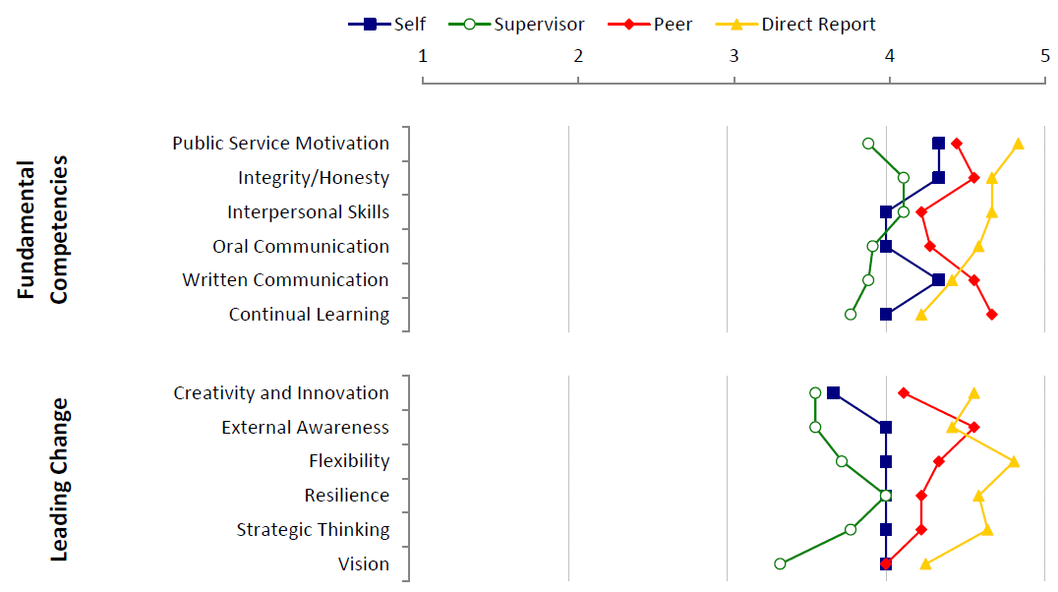
Report Sections: ECQ Profile

Slide 8
Report Sections: Competency/Item Detail

Slide 9
Report Sections: Top 10/Bottom 10 Items

Slide 10
Report Sections: Org Impact Items

Slide 11
Report Sections: Comments

Slide 12
360 Leadership Assessment Database
Population in Database
220,170 raters (self, supervisor, peers, direct reports)
21,621 participants (executives, managers, supervisors, non-supervisory leadership candidates)
  3,099 non-supervisors (14%)
  7,031 supervisors (33%)
  6,307 managers (29%)
  1,789 executives (8%)

Slide 13
Top Five Areas of Success

Slide 14
Top 5 Challenge Areas

Slide 15
Who Sees Individual Feedback Reports?
Participant sees own report
Participant decide whether or not to share it with others
Summary of strengths and development needs may be shared with others
Action plan may be shared with others
Notes:
15
Mid-Level Leadership Development Program

Slide 16
Initial Reactions
What surprised me?
What concerned me?
What pleased me?
What competency ratings do I need more information about?
Notes:
16
Mid-Level Leadership Development Program

Slide 17
You are not your report

