Slide 1
APG Senior Leadership Cohort Program 2014
Speed of Trust
By Stephen Covey
Jason M. Juliano

Slide 2
Leadership Book Review
The Speed of Trust
Author: Stephen Covey

Slide 3
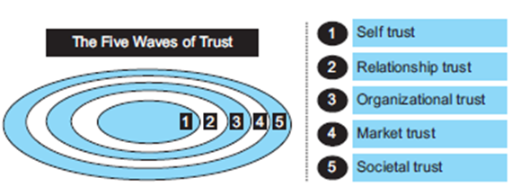
Key Messages from this Book
Trust has a “ripple effect” as when a drop falls into a pool of water. That drop will generate a number of concentric waves. Trust is like this because it always flows from the inside out. In the case of increasing trust, there are five waves, each of which represents a context in which trust is established.

Slide 4
5 Waves of Trust
1) Self Trust: Is derived from your abilities and your capacity to set and achieve goals and keep commitments.
2) Relationship Trust: Essentially boils down to a matter of how you establish and subsequently increase the virtual trust accounts you have with other people. The key here is to act consistently at all times and in all circumstances. High-trust leaders consistently exhibit 13 behaviors, each of which can be learned and then applied by everyone in order to generate trust: (1) Talk straight; (2) Show respect; (3) Be transparent; (4) Right wrongs; (5) Show loyalty; (6) Deliver results; (7) Get better; (8) Confront reality; (9) State expectations; (10) Be accountable; (11) Listen first; (12) Meet commitments; (13) Extend trust.
3) Organizational Trust: When you work with people you trust, more can get done. Organizational trust is derived from alignment – having the organization’s systems, structures and rewards aligned with one consistent objective.
4) Market Trust: Is easy to understand and measure. It is driven by your reputation. When customers, investors and others in the marketplace trust your brand, they act differently.
5) Societal Trust: Increases when you create value for others and for society at large. The key here is to make a meaningful contribution. When you give something back to society, suspicion and cynicism can be offset
or allayed.

Slide 5
Relationship Trust
13 Behaviors of Relationship Trust
(1) Talk straight: Always be honest and up-front about what you’re thinking. Tell the truth
(2) Show respect: Respect the dignity and feelings of everyone you come into contact with.
(3) Be transparent: Be completely open about the facts.
(4) Right wrongs: When you end up being wrong, work very hard at making things right.
(5) Show loyalty: Always give credit where it is due; acknowledge the input and contributions of others.
(6) Deliver results: Establish a track record of getting the right things done.
(7) Get better: Keep upping your game by increasing your personal capabilities.
(8) Confront reality: Address the tough issues and acknowledge what is unsaid
(9) State expectations: Always discuss your expectations so they are clearly defined.
(10) Be accountable: To be trusted, accept that the buck stops with you.
(11) Listen first: Trust grows when you get into the habit of listening before you speak.
(12) Meet commitments: The quickest way to destroy trust is to say one thing and do another.
(13) Extend trust: To earn trust, demonstrate your ability to appropriately trust others.

Slide 6
Quotes I Would Like To Share
“ Trust impacts us 24/7, 365 days a year. It undergirds and affects the quality of every relationship, every communication, every work project, every business venture, every effort in which we are engaged. Contrary to what most people believe, trust is not some soft, illusive quality that you either have or you don’t; rather, trust is a pragmatic, tangible, actionable asset that you can create” Stephen Covey
“As a leader, you can be successful at the Self Trust and Relationship Trust levels so that people trust you as a person, but then fail at the Organizational Trust level by not designing and aligning systems that promote trust.” Stephen Covey
“Men build too many walls and not enough bridges” Sir Isaac Newton

Slide 7
What This Book Meant To Me
A good reminder of self behaviors when moving into leading a new organization.
Very simple behaviors that are not just important to business but also personal relationships
My opinion is that we lack and fail to understand how to build trust within organizations.

