Slide 1
APG Senior Leadership Cohort Program 2014
Book Presentation
by
Willie Jackson

Slide 2
Leadership Book Review
General H. Norman Schwarzkopf
The Autobiography
“It Doesn’t Take A Hero”
Written With
Peter Petre

Slide 3
Key Messages from this Book
This autobiography covers General Schwarzkopf life from early childhood through retirement from the Army.
The pressure and challenges faced with America’s leaders on a daily basis.
How he shaped his life and philosophy from different experiences that occurred through his life…as well as all the people that he worked for and with during his military career.

Slide 4
Key Messages from this Book
The book provided a greater sense of who General Schwarzkopf really is.
Provided insight to how a leader is developed
Provided a better appreciation of how difficult it is for soldiers (private to generals) to fight a war while they also fight the politicians in Washington.
What really struck me is that he left out the names of many people he really disagreed with to prevent attacking them personally. He does mention names when he is giving praise.

Slide 5
Key Messages from this Book
Decision Making
Provides insight on how decisions are made in the upper echelon of government that affect the lives of hundreds of thousands of people as well as the prestige of the United States.
What is the thinking behind those decisions?
What variables are being considered and why?
What is the process?
This book does an excellent job of bringing to light the trials and troubles associated with war, and more importantly when we should go to war and why war is necessary

Slide 6
Quotes I Would Like To Share
“It doesn’t take a hero to order men into battle, it takes a hero to be one of those men who goes into battle.”
“Do what is right, not what you think the high headquarters wants or what you think will make you look good.”
“The more you sweat in peace, the less you bleed in battle.”
“Leadership is a potent combination of strategy and character. But if you must be without one, be without strategy.”

Slide 7
Quotes I Would Like To Share
“The mothers and fathers of America will give you their sons and daughters…with the confidence in you that you will not needlessly waste their lives. And you dare not. That’s the burden the mantle of leadership places upon you. You could be the person who gives the orders that will bring about the deaths of thousands and thousands of young men and women. It is an awesome responsibility. You cannot fail. You dare not fail…”

Slide 8
What This Book Meant To Me
Strong book with many life lessons. A true American hero who has re-defined the meaning of leadership and being a family man.
His ability to do his job while voicing candid self awareness, and he never allows his ego to cloud his judgment.
The massive sea and air deployment to the Gulf and the behind-the-scenes political wrangling—is some of the most compelling of the book.

Slide 9
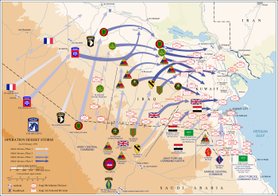
Planning Maps

