Slide 1
Book Review – Heart of A Lion
The Leadership of LT Michael P. Murphy, U.S. Navy Seal
By Gary Williams
Rachel Glassman
9 February 2016

Slide 2
About this book…
Follow-on to SEAL of Honor: Operations Red Wings and the Life of LT Michael P. Murphy USN.
When conducting research and writing Seal of Honor, the author noticed the leadership qualities described in reference books mirrored those of LT Murphy.
Includes leadership quotes and philosophies of the likes of John Maxwell, Jim Rohn, Donald T. Philips and a host of Military Guides and Reading Lists.

Slide 3
Recipe for Leadership
Influence, Character and Integrity
Before you can lead, you must positively influence others
Character
Not born with it; develop an unshakable moral character
Integrity
You’re best friend, it will never betray you or put you in a compromising position
Always act with integrity consistent with that character – an integrity and character that transcends position-only leadership and provides the all-important moral authority to lead

Slide 4
Selfless Service to Others
Always humble
Put team’s interests before his own
Loyal
Able to see the good and bad in people – bad people can do good things and good people can do bad things
Always giving the benefit of any doubt
When described; the word Integrity was a constant
Favorite Leader: Abraham Lincoln
Moved away from the cliff wall and out into the open–and into the hail of Taliban bullets; calmly walked out to meet certain death to make the call. He took a bullet in the back, with blood spurting from his chest, he said “Roger that, sir. Thank you.” Then he stood and staggered back, and still kept firing.

Slide 5
LT Michael P. Murphy Leadership Traits
Confidence
The Little Engine that Could
Accept Personal Responsibility
Leaders can delegate duties and even authority, but cannot delegate their responsibility
Ability to Learn the Job
All leaders make mistakes, but great leaders never make the same mistake twice.
Communication
Listen to others, don’t just hear them
Enable Others
Great leaders gain authority by giving it away
Leaders are Readers
We usually find what we are searching for, so make sure you are searching as you are reading
What are you reading; is it stimulating your mind and thought process
Lead by Example
Best leaders need fewer words because they lead with their lives
The first one to become emotional in any situation losses
No one is fit to command another than cannot command their self.
Leave a Legacy
Legacies we leave are part of the ongoing foundation of life, and we are but stewards of this world, with an obligation to leave it better than we found it

Slide 6
Lasting Impressions
All decisions have a consequence.
A favorable outcome doesn’t always indicate that the correct was made just as surely as an unfavorable outcome doesn’t always indicate that a wrong decision was made.
Doing the right thing is always the right thing to do.

Slide 7
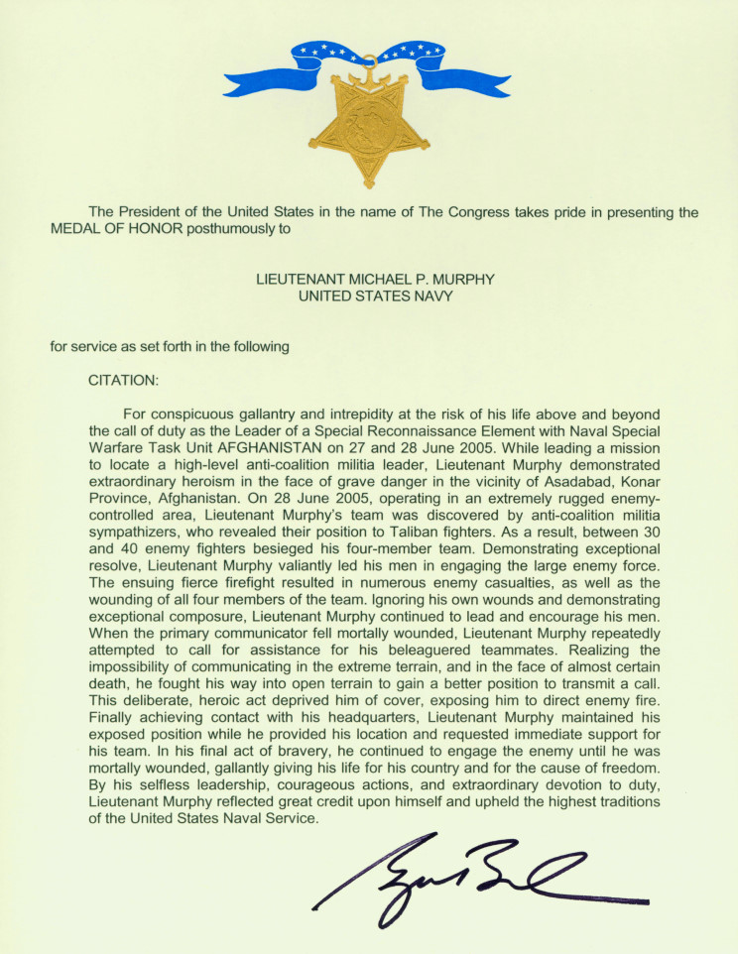
“Leadership is intangible, and therefore no weapon ever designed can replace it.”
-GEN Omar Bradley
Command & General Staff College
“It was never about him, but always about others.”
Gary Williams on LT Michael P. Murphy

Slide 8
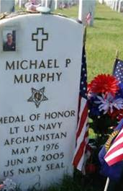
Other Inspiring Books & Sources of Information
SEAL of Honor, Gary Williams
Lone Survivor, Marcus Luttrell with Patrick Robinson
Service, Marcus Luttrell with James Hornfischer
More on LT Michael P. Murphy: https://michaelpmurphy.wordpress.com/
More about Operation Red Wings: http://www.navy.mil/moh/mpmurphy/soa.html

