Slide 1
APG Senior Leadership Cohort Program 2014
Book Presentation
Susan Harbort

Slide 2
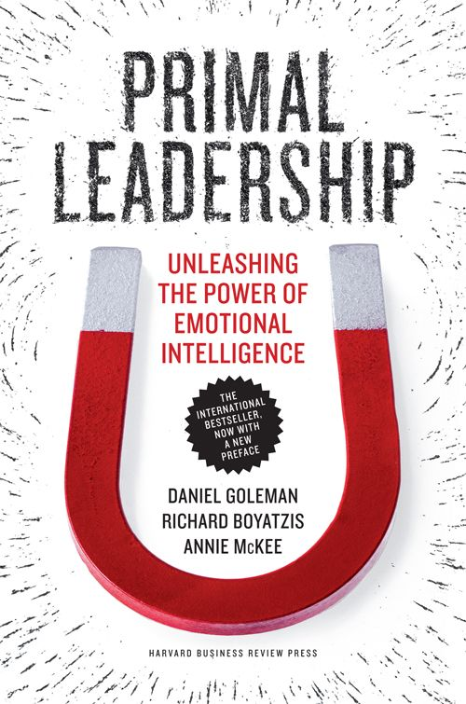
Leadership Book Review
Primal Leadership: Unleashing the Power of Emotional Intelligence
Authors: Daniel Goleman, Richard Boyatzis, and Annie McKee

Slide 3
Key Messages from this Book
The science: open-loop limbic system. An open-loop system depends largely on external sources to manage itself. This means that other people can change our physiology and our emotions.
Emotions are more powerful than intellect. Emotions are controlled by the brain’s amygdala, while rational decisions come from the prefrontal cortex. Dialog between these centers orchestrates thought and feeling.
Resonant vs. dissonant leadership: resonant leaders use empathy to attune to the emotions of the people they lead. Dissonant leaders lack empathy and create a discordant and toxic environment.
Four domains of emotional intelligence: self-awareness, self-management, social awareness and relationship management.
When people feel good, they work at their best. Feeling good improves mental efficiency, making people better at understanding information and using decision rules in complex judgments.

Slide 4
Quotes I Would Like To Share
“For too long managers have seen emotions at work as noise cluttering the rational operation of organizations. But the time for ignoring emotions as irrelevant to business has passed. What organizations everywhere need now is to realize the benefits of primal leadership by cultivating leaders who generate the emotional resonance that lets people flourish.”
“Emotionally intelligent leaders look inside – at what they feel, think and sense about the organization. They connect with the company’s ideal vision and mission, and notice the gaps between what could be and what is.”
“Emotionally intelligent leaders know how to manage their disruptive emotions so that they can keep their focus, thinking clearly under pressure.”
“EI contributes 80-90% of the competencies that distinguish outstanding from average leaders.”

Slide 5
What This Book Meant To Me
Resonance also stems from particular leadership styles. Visionary, coaching, affiliative and democratic styles foster resonance. Pacesetting and commanding styles are more likely to create dissonance.
The best leaders use different styles depending on the situation, and are able to switch between different styles. The leaders who have mastered the four resonance-building styles foster the best climate and business performance.
Because my leadership style is primarily pacesetting, I need to practice the more resonant leadership styles in my organization. I am trying to incorporate the visionary, coaching, affiliative and democratic leadership styles into my repertoire.

