Slide 1
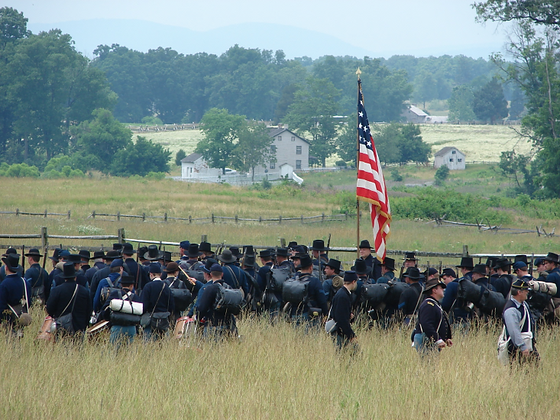
Gettysburg Battlefield Tour
8 October 2014
When: 8 October 2014 (Wednesday)
Who: An Army War College Historian will provide APG 6 participants a guided tour of the historic battlefield
Where: Meet at Exit 85, Park n’ Ride near the HEET Center
How: Motor Coach (50 passenger, equipped with rest rooms). *All participants must ride the bus since it is an interactive part of the battlefield tour.
Departure/Return Times: 7:00 am and 5:30 pm
Considerations: Comfortable clothing and shoes (walking the battlefield), clothing appropriate for the weather, water bottle/snacks/back pack/camera if desired.
Lunch: Dobbin House Tavern @ 1200 (Registered Historic Landmark)
Cost: $15.50 for lunch (Participants must bring exact $$ and payable to Claire Meany the morning of departure.)
Gettysburg is known throughout the world as a famous American Civil War battle site and the site of President Abraham Lincoln’s Gettysburg Address.

