Slide 1
ASPR/BARDA Mid Career Leadership Cohort
June 1-2, 2015

Slide 2
Learning Objectives
Conduct an environmental scan and explore emerging future leadership challenges - clarify related leadership imperatives to guide our leadership.
Explore our leadership and lives through the lens of Joseph Campbell’s Hero’s Journey – learn a process for accessing deep values and learned wisdom
Create a Leadership Purpose Statement based on your deep values
Craft stories to communicate who we are as leaders and what we stand for
Practice telling our leadership stories – listen to others telling their stories – receive and provide feedback
Focus on the future by beginning a leadership action & development planning process

Slide 3
Agenda
Day 1
Context/Environmental Scan – Leadership of the Future
Our Leadership Journeys & What We’ve Learned Along the Way
Book Review Marketplace
Clarifying our Leadership Purpose
Begin Crafting Leadership Stories
Day 2
Telling our Stories
Book Review Marketplace
Program Review& Feedback
Leadership Development Planning
Close the Learning Community
Notes:
Facilitated learning to surface collective experience and wisdomDel
Be here now

Slide 4
Environmental Scan
Exploring our context for leadership
Where we’ve been
Where we are
Where we’re going
What will be required
Decades: 1995-2005 … 2005-present … next decade…
Notes:
Line up from first joined to most recent: Around a decades chart (6 people)

Slide 5
Rapid Fire Interviewing (15 min)
Over next 10 minutes you’ll interview two people – who are each assigned a different timeframe than you
With each interview, you’ll ask your questions & take notes for a couple of minutes and then you’ll answer your partner’s questions
Make brief notes as you go
At the bell find a new partner and repeat
Notes:
Opening questions to large group…
For your decade… who was president? What music were you listening to? Where were you working or going to school? Who were you married to or dating? What were the styles?

Slide 6
Consolidation Phase (15 min)
In your assigned timeframe group - share your notes
What themes and patterns do you see?
Create a chart that captures …
    What was going on … news – big stories – events
    US and world events
    Significant economic events & trends
    BARDA-related events and trends
    Technology
    Government policy & regulation
    Other notable items
Choose a reporter

Slide 7
What it Means to Lead – Revisited…
  Leading Content – using our expertise
  Leading Context – creating conditions for others to contribute & achieve
  Scanning the Environment – track what’s emerging
  Articulating a Future – the way forward
  Mobilizing People & Energy – to learn, address challenges & harness opportunity
  Building Capacity to Deliver the Future -people – culture – processes - systems
  Adapting & Refocusing – as we learn

Slide 8
Leadership for the Future (10 min)
In Groups of three - based on the future trends we’ve identified
What will leaders need to be able to do to lead powerfully and effectively in this future we forsee?
  Make a list of 4 skills – attributes – values

Slide 9
Leadership for the Future (10 min)
Join another group of three
Discuss & consolidate your answers
Choose 5-6 of the most important leadership skills - attributes – values for the future
  Write each on an 8½ x 11 card

Slide 10
Personal Reflections
“Legacy thinking means dedicating ourselves to making a difference … appreciating that others will inherit what we leave behind” – Kouzes & Posner
  What does this mean for me personally – for how I lead myself and others?
  What do I want to leave behind?
  What is the leadership imperative for me – what’s critical – what moral responsibility do I have?

Slide 11
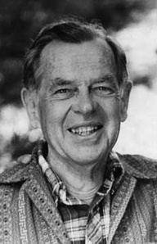

The Hero’s Journey

Slide 12
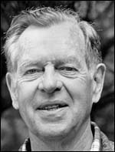
Joseph Campbell's belief
“A hero ventures forth from the world of common day into a region of supernatural wonder: fabulous forces are there encountered and a decisive victory is won: the hero comes back from this mysterious adventure with the power to bestow boons on his fellow man.”
“The hero with a thousand faces”

Slide 13
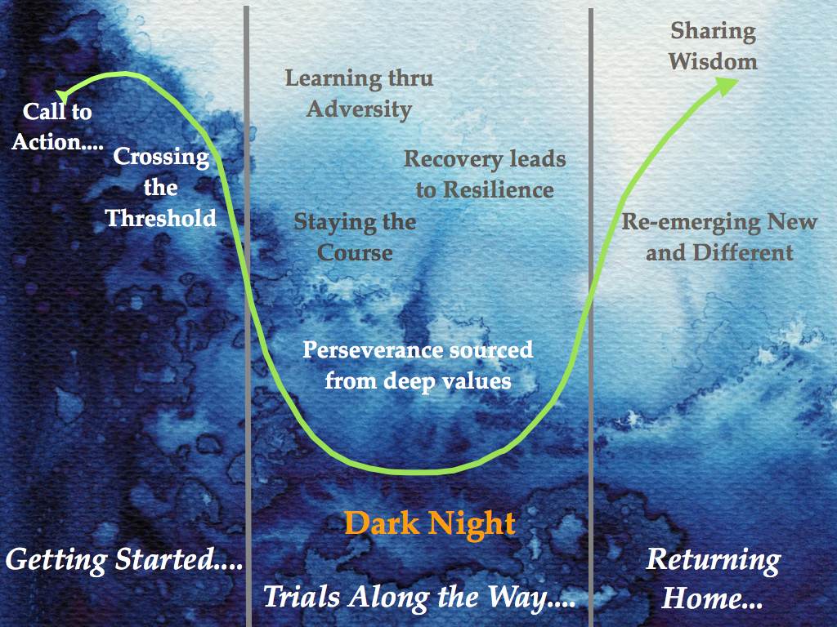

Slide 14
The heroic journey is sustained by two fundamental processes
  The Capacity for Resilience
  Awareness of Our Deep Values
      …the deep intent that drives us
Notes:
14
Campbell uses Restoration instead of Resilience and Deep Intent instead of Deep Values

Slide 15
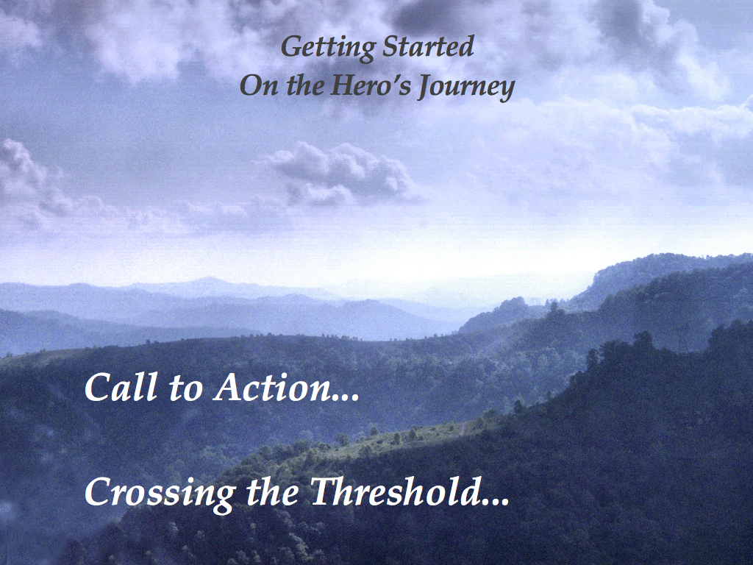
Notes:
15
Video clips
– Matrix: Blue Pill/Red Pill: Crossing the Threshold;
Johnny Cash: Audition Scene
Flip Chart questions for all three slides: what parts of the hero’s journey does this clip speak to?
Departure, separation, letting
Refusal of call
Everything is running smoothly... until something unusual happens
The hero’s first wise reaction is to reject the call for adventure: Fight, flight or freeze...
The hero is wise, weighs pros & cons and decides not to respond. Conditions may not yet be right
The call gets stronger and more compelling
The first defining moment of heroism takes place when the hero finally decides to accept the call
The hero has the choice: continue “business as usual” or explore, be curious
The Call for Adventure suggests a possible dramatic change from the actual situation

Slide 16
The Call to Action...Crossing the Threshold
Matrix Clip: Red Pill/Blue Pill
Johnny Cash Clip
Notes:
Matrix Video

Slide 17
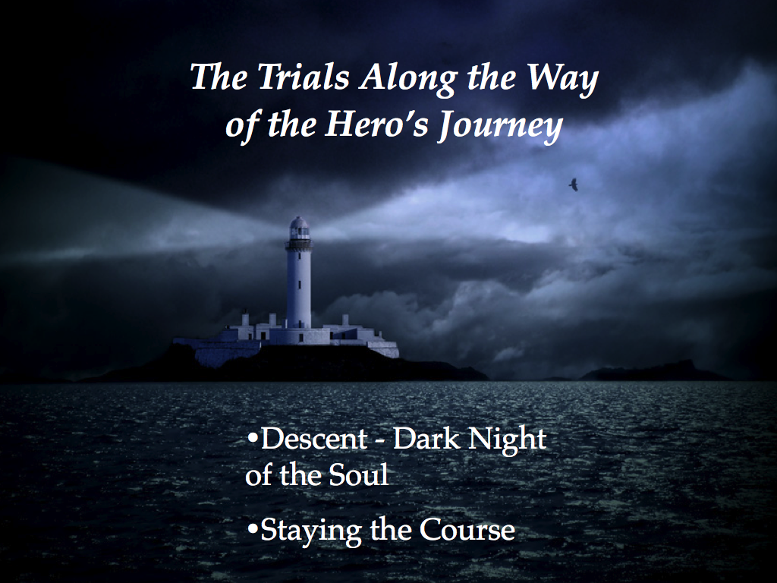
Notes:
Video Clips
Andrew Johnson – Bullying … Staying the Course – Meeting the Nemesis… Deep values/intent
- MLK – I have seen… the dark night of the soul
The road of trials
Refusal of return
Master of 2 worlds

Slide 18
Dark Night of the Soul...
Trials Along the Way...
  Andrew Clip
Dark Night of the Soul...
  Martin Luther King Clip
Notes:
Martin Luther King Speech

Slide 19

Returning Home from the Hero’s Journey...
Reemerging New and Different
Sharing the Wisdom of the Journey
Notes:
Video Clip – Nick Vujicic
Bringing back the gift that could only be gotten from the journey
Returning to the community

Slide 20
The Return Home....
Nick Vujicic clip

Slide 21

Without Recovery there is no Journey...
  Heroes have the capacity to recover throughout the many challenges of the journey – Recovery builds Resilience
  Each fall is an occasion to learn
  The Recovery is rooted in your Deep Values
Notes:
21

Slide 22
Self Reflection
Based on what we’ve discussed about the ‘Hero’s Journey’ – think about different ‘journeys’ you’ve taken in your lifetime…
Choose one you want to work with today
Using the Building Your Personal Story handout – make some notes on the different stages of this journey

Slide 23
Sharing the Journey
Share the story of your journey with a partner
Partner
Help draw out details from different parts of the journey
Listen for deep values
What important learnings occurred?
15 minutes then switch

Slide 24
Large Group Discussion
What do you take away from your exploration of your journey today?
      Surprises?
      What got clarified?
      What opened?
      Role of teachers and guides
      Learning
      Wisdom
  How can this process be helpful to you going forward?

Slide 25
Day 1 Afternoon

Slide 26
What You Stand for As a Leader
Think back over the past months in this program … what stands out … make a few notes to yourself …
    Session topics of greatest impact for you
    Your journaling reflections
    Important interactions with cohort members, instructors, coach, mentors …
    PEM: Learnings about managing your energy
    Your leadership behavior shifts & impact
    The leadership imperative from earlier today

Slide 27
Purpose to Impact Article Summary
Concise statement … Drawn from important life experiences … About what is deeply meaningful to you … Leaves you feeling emboldened & energized
  Language that is uniquely meaningful to you
  Focus on big picture aspirations
  Emphasize your strengths & gifts
  Include all of life… work, family & community
Craft a brief purpose statement & 2-3 sentence explanation

Slide 28
Building Your Stories
Choose a picture that captures the spirit of your purpose statement
In your group – share your purpose statement & explanation; tell the story of the picture you chose.
Listeners: what is important to this person? One suggestion to make the statement or explanation sharper or clearer

Slide 29
Narratives
A Narrative links a set of events in some kind of causal sequence
Narratives create compelling pictures of a leader’s goals and intentions
Notes:
We tell stories all the time—about challenges, about their weekends, days events..the stories carry messages-about what we are focusng on, what we care about. We want to start getting more conscious and purposeful about the stories we tell. Think about think abt the leadership imperative from yesterday. Look thru these pictures depict the messages you want to tell. Choose 6 that speak to the messages thay want ot send and what you wnt to communicate to the org.
so what is the story you want to tell??

Slide 30
Storytelling ROI
78% of a leader’s work involves ‘talking’ (Mintzberg)
  Get your message to stick better - increase your effectiveness
What’s the cost of telling a story?
  Ergo - ROI can be massive …
Study of 50 Six Sigma BPR Efforts
  42% exceeded targets by 200-300%
  A key differentiator – intentional storytelling to put the effort in context, make the case for why this, why now and show the way forward
Notes:
Do you have the stories (and storytellers) you need to capture peoples' hearts and minds and move your organization forward this year?
According to Forbes*, use of storytelling in the workplace is on the rise because a good story is more effective than a good lecture. "Great business leaders from Jack Welch to Steve Jobs have always understood how to use stories to create transformative organizations and sell products. Now events like the TED Conference have elevated storytelling as a sought after talent within the business community."
CRM Learning is pleased to announce a brand new program that illustrates the difference between just conveying information and creating a moving experience through story:
Tell Me a Story - A Powerful Way to Inspire Action <http://www.crmlearning.com/tell-me-a-story?utm_source=Service&utm_medium=Email&utm_campaign=J13G1>
As you will see in the program, stories present information on a level that is hard to reach with mere facts and statistics. Leaders can use storytelling to help employees:
experience less fear around new changes
overcome setbacks and move forward
commit to challenging goals
embrace organizational values
Featured communication expert John Jenson, and leaders from a variety of industries, show how to find a story worth telling, link the story to a relevant point and then tell the story well.

Slide 31
Powerful Stories – Three Elements - Aristotle
Logos
Well structured content - appeals to the mind
intellect - rational – logical
Ethos
Behavior matches message – believable
embodied – walking the talk
Pathos
Connects to emotion & passion – heart of the matter emotional anchor - metaphor

Slide 32
Architecture of Good Stories
Personal Story
  Open with a personal story from your life
Springboard
  Create a springboard that makes the bridge from the personal story to the point you want to make
The items you what to emphasize (1-3)
  Name the 1-3 … speak to each separately … summarize
Closing
  Link back to the personal story to summarize and close

Slide 33
Make your Stories Memorable…
Talk about what you know
Refer to people who are related to the story
Refer to experiences shared with the audience
Use variety – words – tone – pace – movement - props
Use humor, when appropriate
Link to what’s important to your listeners

Slide 34
…Getting Their Attention…
Tell a story about the audience’s problems
Admit a vulnerability – share a tale of adversity
Ask a question
Use a striking metaphor
Launch an unexpected exercise
Issue a challenge
Share something of value

Slide 35
What we say … or how we say it?
Tone of voice
38%
ethos - pathos
Body language – 55%
ethos - pathos
Words used
7% -logos
Source: Mehrabian & Ferris, 1967, “Inference and attitudes of non verbal communication” Journal of Counseling Psychology Vol 31 pp 248 - 252

Slide 36

The Emotional Anchor pathos causes us to remember a good story
Notes:
Anchor by engaging emotions – yours and theirs…
Voulitional Memory vs Emotional Memory

Slide 37
Proverbs and Maxims
A rolling stone gathers no moss
A stitch in time saves nine
Actions speak louder than words
All roads lead to Rome
All work and no play make Jack a dull boy

Slide 38
Proverbs and Maxims
An ounce of prevention is worth a pound of cure
Better safe than sorry
Big oaks from little acorns grow
Don’t put all your eggs into one basket
Experience is the best teacher

Slide 39
Proverbs and Maxims
For every drop of rain that falls, a flower grows
He who tends a fig tree will eat its fruit
It takes two to tango
Jack of all trades, master of none
Keep your nose to the grindstone
He who hesitates is lost

Slide 40
Proverbs and Maxims
Something must be seen to be believed
Rome wasn’t built in a day
Nothing ventured, nothing gained
Out of sight, out of mind
The early bird catches the worm
You can lead a horse to water but can’t make him drink

Slide 41
Crafting Powerful Stories
Prepare your Story – first cut
Identify a situation you have coming up where you could tell a story to make your point
Make some notes on the storytelling worksheet
Partner Review – feedback – evolve story
Overnight – enhance your story and be prepared to tell it in the morning

Slide 42
Build Stories
(Consider These Prompts to Start Your Thinking)
  What you’ve learned
  Impact of your work
  Ripple effect of your work
  Plans to keep the work going
  A fabulous failure
  Where you missed the mark
  Regrets you have
  What you would do differently

Slide 43
Day II

Slide 44
Small Group Storytelling
Process | Outcomes
Choose a Timekeeper Tell your story – 5 min Write notes - 2 min Deliver feedback – 10 min Hand over feedback notes Switch | Practice delivering your story Observe others Give feedback Choose one story to be delivered to the whole group

Slide 45

The Academy Awards

