Slide 1
APG Senior Leadership Cohort Program 2015
Book Presentation: "Extreme Ownership: How U.S. Navy SEALs Lead & Win“
Paul Terzulli
19 Nov 2015

Slide 2
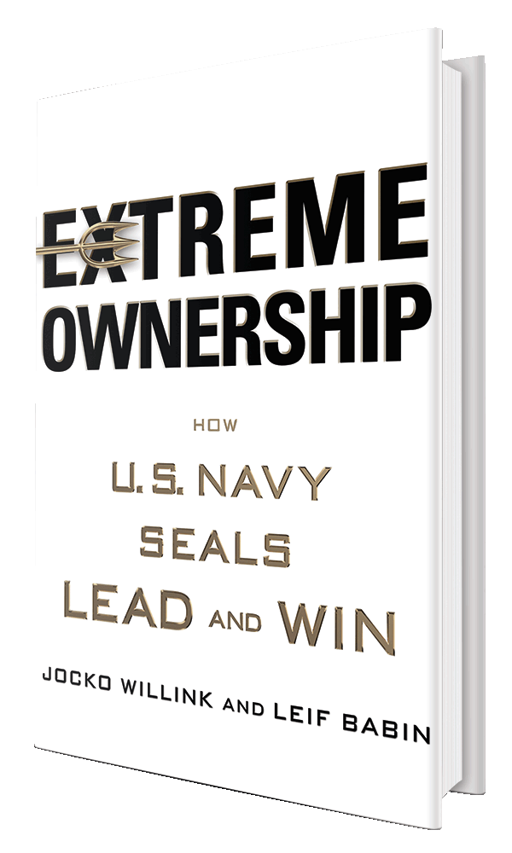
Leadership Book Review – “Extreme Ownership: How U.S. Navy SEALs Lead & Win”
Authors: John “Jocko” Willink & Leif Babin
New York Times Bestseller List (8 Nov 15 – Present)
ISBN: 1250067057
Publisher: St. Martin’s Press
Release: 20 Oct 2015
Notes:
Extreme Ownership Website: http://www.echelonfront.com
Extreme Ownership Facebook: https://www.facebook.com/extremeownership/
NY Times Bestseller List (15 Nov 2015): http://www.nytimes.com/best-sellers-books/2015-11-15/hardcover-nonfiction/list.html

Slide 3
Key Messages from this Book
Extreme Ownership - a leader must own everything in his/her world. There is no one else to blame.
Leadership is universal. Concepts crucial to accomplishing the most difficult missions in combat equally apply to any group, team, or organization.
Laws of Combat Leadership:
Cover & Move. Coordinated cooperation & collaboration.
Simple. Keep it simple. A simple plan is better than a complex plan.
Prioritize & Execute. Relax, Look Around, Make a Decision.
Decentralized Command
Lead “Down” the Chain of Command. Leaders must decompose and communicate strategy to subordinate leaders.
Lead “Up” the Chain of Command. Leaders as SMEs with implied task to inform and educate upstream leaders (“higher headquarters”).
Notes:
Background: Willink and Babbin are former U.S. Navy Sea, Air Land (SEAL) sailors. They served together in SEAL Task Unit Bruiser, the most highly decorated USSOCOM unit from Operation Iraqi Freedom (OIF). Their efforts contributed to the historic triumph for U.S. forces in Ramadi, Iraq. Chris Kyle, most lethal sniper in U.S. history (basis for ‘American Sniper’ book/movie) was also assigned to SEAL Task Unit Bruiser.

Slide 4
Quotes I Would Like To Share
“There are no bad teams, only bad leaders.”
“Those who will not risk, cannot win“
“A leader has nothing to prove, and everything to prove.”
“Instead of letting the situation dictate our decisions, we must dictate the situation.”
“…Leaders cannot be paralyzed by fear. That results in inaction. It is critical for leaders to act decisively amidst uncertainty; to make the best decisions they can based on only the information they have available”
“In combat, as in life, the outcome is never certain, the picture never clear. There are no guarantees of success. But in order to succeed, leaders must be comfortable under pressure and act on logic not emotion. This is a critical component to victory.”
“Breaking [the 'us versus them‘] mentality is key to properly leading up the chain and radically improving performance.”
Notes:
Additional quotes:
“…Experience…taught me - the picture can never be complete; there [is] always some element of risk; there is no 100% right solution.”
“A public display of discontent or disagreement with the chain of command undermines the authority of leaders at all levels. This is catastrophic to the performance of any organization.”
“Leaders must be confident not cocky; brave not foolhardy; accept risk, act courageously - but not reckless; always mitigate those risks that can be controlled with out impact to the team or expending critical resources; leaders must have a competitive spirit, but be gracious losers; mission success above personal success; attentive not obsessesed; not bogged down in spite of strategic success; strong, but have endurance; perform at highest level and sustain for long term; humble, but not passive; quiet, but not silent; learn from mistakes; speak up when it matters; respectfully pushback for the team; close with subordinates, but not too close; understand motivations of people, team, families; calm, not robotic”

Slide 5
What This Book Meant To Me
Humbling; many lessons to learn, despite diverse background of leadership roles and positions (e.g. scouting, military/operational, industry, civil service)
Across various walks of life, there are in fact ‘universal’ principles of leadership
One principle, “Extreme Ownership” shows us that a leader first and foremost takes responsibility for all aspects of his mission and organization.
Leadership is built on mutual trust and respect, upstream and downstream.
Status, rank, office, charter/flag, title/role are all positional forms of authority. True leadership comes from within and is cultivated most in a human dimension.
We relate to one another as leaders through the human dimension, which ultimately is how good and bad leaders are identified.

