Slide 1
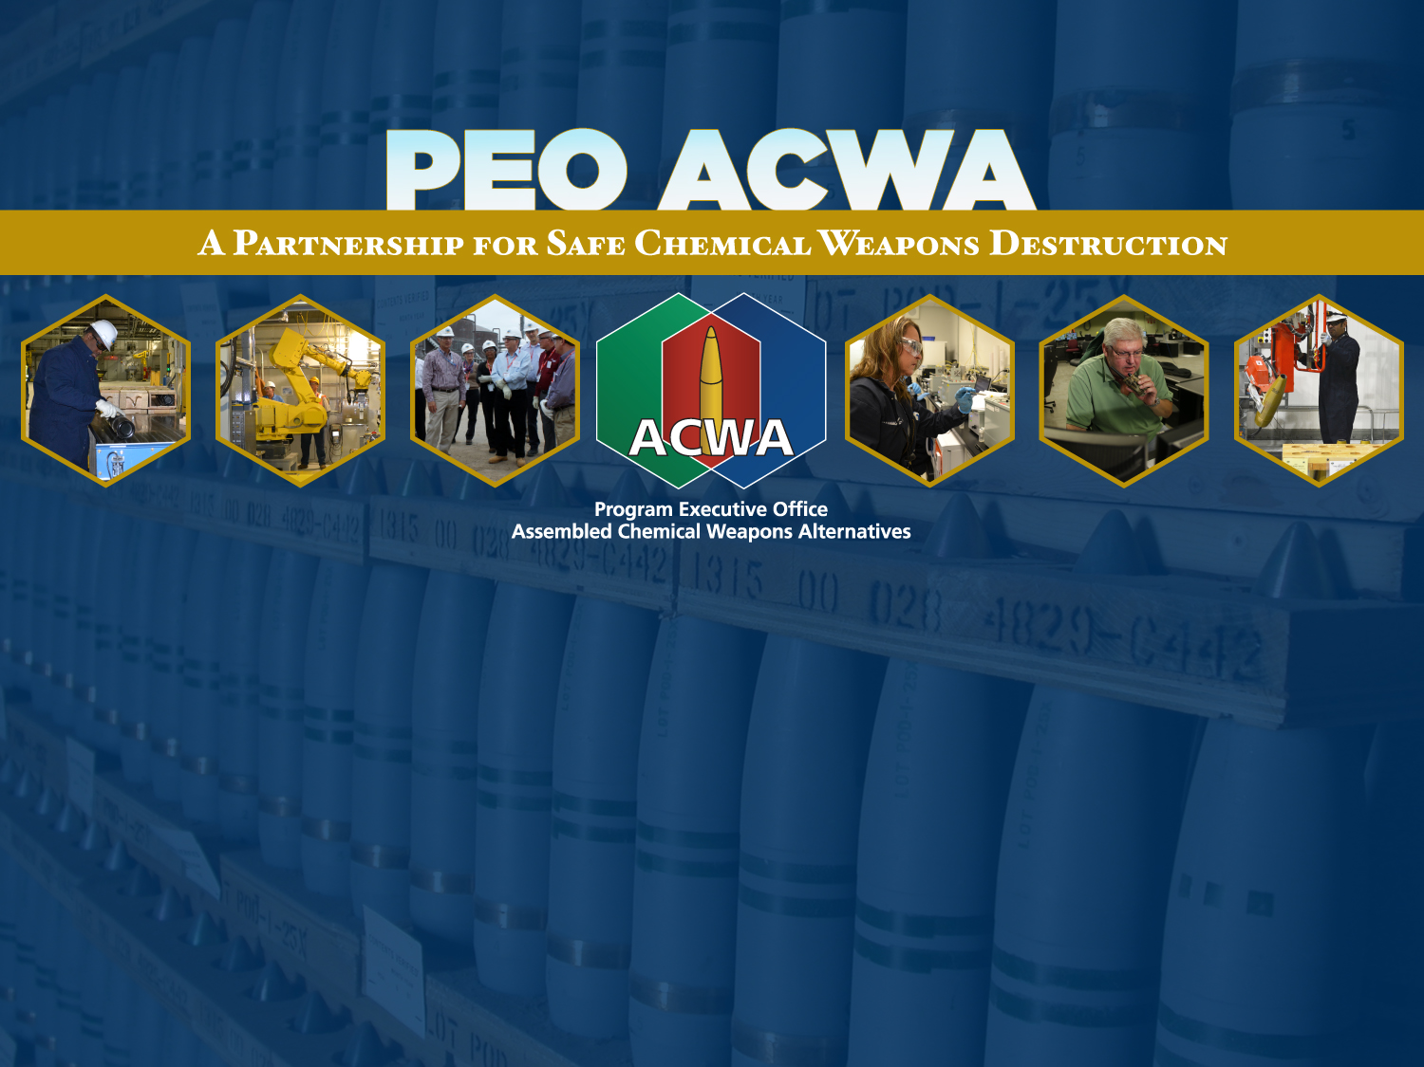
PEO ACWA Overview for COHORT 8
November 2016
Notes:
Good morning (afternoon). I am (state your name) and on behalf of our Program Executive Officer, Conrad Whyne, I would like to welcome you to the Assembled Chemical Weapons Alternatives program, known as “ACWA” and your new employee welcoming orientation. The purpose of this orientation is to give you a brief overview of the program, how it came to be, the scope of its responsibility, and some of the signature values you will be expected to embrace as we welcome you to the ACWA team.

Slide 2

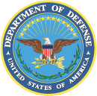
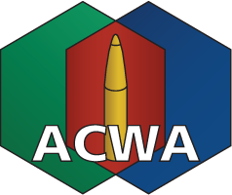
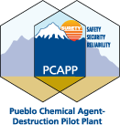
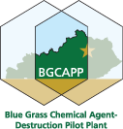


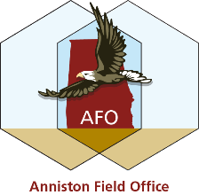
Program Background
    Research and demonstrate alternatives to incineration for assembled chemical weapons that meet the applicable safety and environmental requirements.
1996
    Responsibility to manage the destruction of the Pueblo, Colorado and Blue Grass, Kentucky chemical weapons stockpiles using chosen alternative technologies.
2002
2002
Neutralization followed
by biotreatment.
2003
Neutralization followed by supercritical water oxidation.
APPROVED FOR PUBLIC RELEASE – UNCLASSIFIED
Notes:
The ACWA program came into existence in 1996 as a mandate by Congress to investigate alternatives to the incineration technology being used at the other U.S. destruction facilities. Congress felt that the organization responsible for investigating these alternative technologies should be kept separate and distinct from the Army agency responsible for the incineration technology. As a consequence, a law was passed stipulating that ACWA would report directly to the Department of Defense instead of Department of the Army, a requirement that continues to this very day.
ACWA spent its first five years researching and demonstrating six alternative destruction technologies. By late 2002/early 2003, after working through a comprehensive process that involved numerous government agencies, industry, and the public, two of these alternative technologies were officially selected for the Pueblo and Blue Grass stockpiles.
Neutralization followed by biotreatment was selected for the mustard stockpile at Pueblo, and neutralization followed by a process known as Supercritical Water Oxidation was selected for mustard and nerve agent stockpile at Blue Grass. The fundamental difference between these two technologies and incineration is that neutralization involves destruction of the chemical agent by means of a chemical reaction whereas incineration involves destroying the agent by open flame combustion. While incineration has been proven repeatedly to be a safe and environmentally sound technology, the Colorado and Kentucky communities were opposed to it and opted through their elected representatives to adopt neutralization as an alternative.
Systems contracts were subsequently awarded for the design, construction, systemization, operation and closure of facilities employing neutralization chemical agent destruction. Bechtel National, Inc. was awarded the contract for the Pueblo facility and a Bechtel-Parsons joint venture was awarded the contract for the Blue Grass facility.

Slide 3
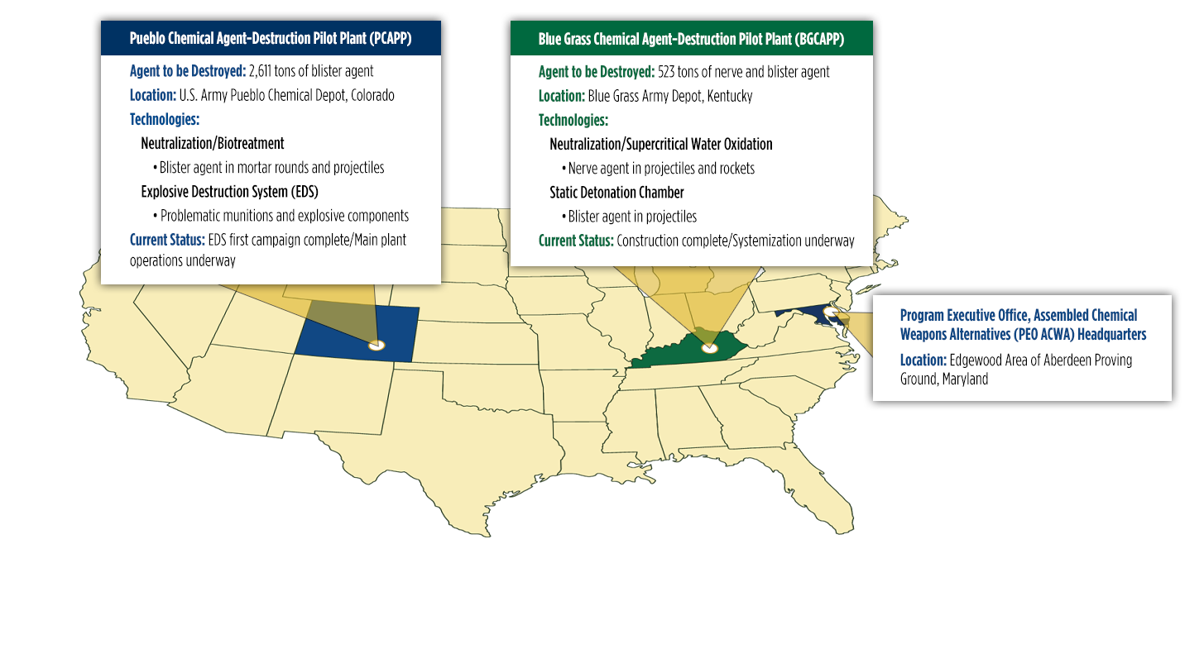

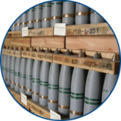
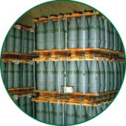
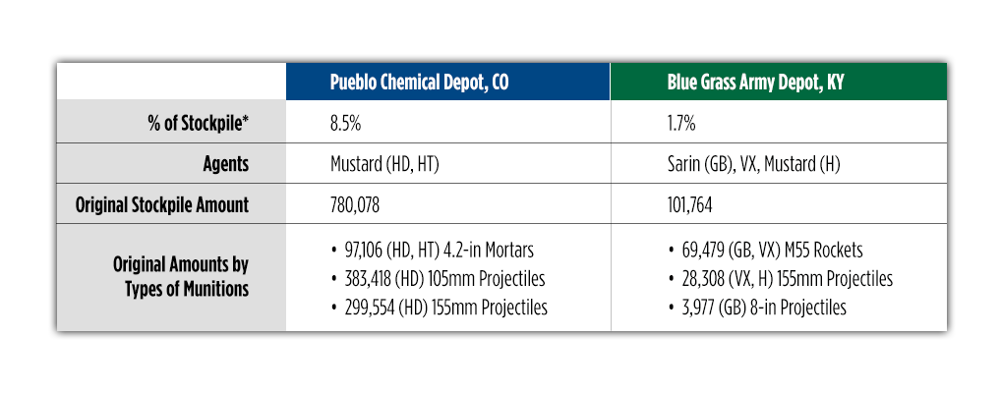
PEO ACWA’s Chemical Demilitarization Program Role
* Percentage of entire original US stockpile, including U.S. Army Chemical Materials Activity sites not shown
APPROVED FOR PUBLIC RELEASE – UNCLASSIFIED
3
Notes:
These are the two specific stockpiles for which the ACWA program is responsible for destroying.
The stockpile at Pueblo consists entirely of projectiles and mortar rounds filled with mustard agent.
The Blue Grass stockpile, which is the smallest of the declared U.S. storage locations, has the greatest variety of chemical weapons, consisting of both mustard and nerve agent projectiles, as well as the last remaining U.S. stockpile of nerve agent-filled rockets.

Slide 4
PEO ACWA Project Stages
1. DESIGN
2. CONSTRUCTION
3. SYSTEMIZATION
Facility is specifically designed to safely and efficiently destroy chemical weapons.
Completed in three phases, construction will be led by a team that has successfully designed, built and/or operated all of the existing chemical destruction facilities in the U.S.
All machinery, equipment and processes are operated and tested with water or simulants to ensure
they function together as an integrated system.
4. PILOT TESTING
5. OPERATIONS
6. CLOSURE
Once systemization is satisfactorily completed, pilot testing begins with the gradual introduction of actual agent-filled munitions into the system.
Once pilot testing has been successfully demonstrated and is proven to be in compliance with all safety requirements and environmental permits, the remaining chemical weapons are destroyed.
Operations are complete, and the facility is closed. Equipment is dismantled, decontaminated and removed in accordance with agreements between the state and the U.S. Army.
Notes:
Our projects must go through a number of phases before any actual destruction operations can begin. To maintain progress, we’ve always employed a waterfall approach to the stages. For example, construction continues in Blue Grass, but as equipment and systems are completed, they are transferred to the start-up team for systemization. Systemization is a preparatory phase where all processes and equipment are tested to ensure they are working properly.

Slide 5
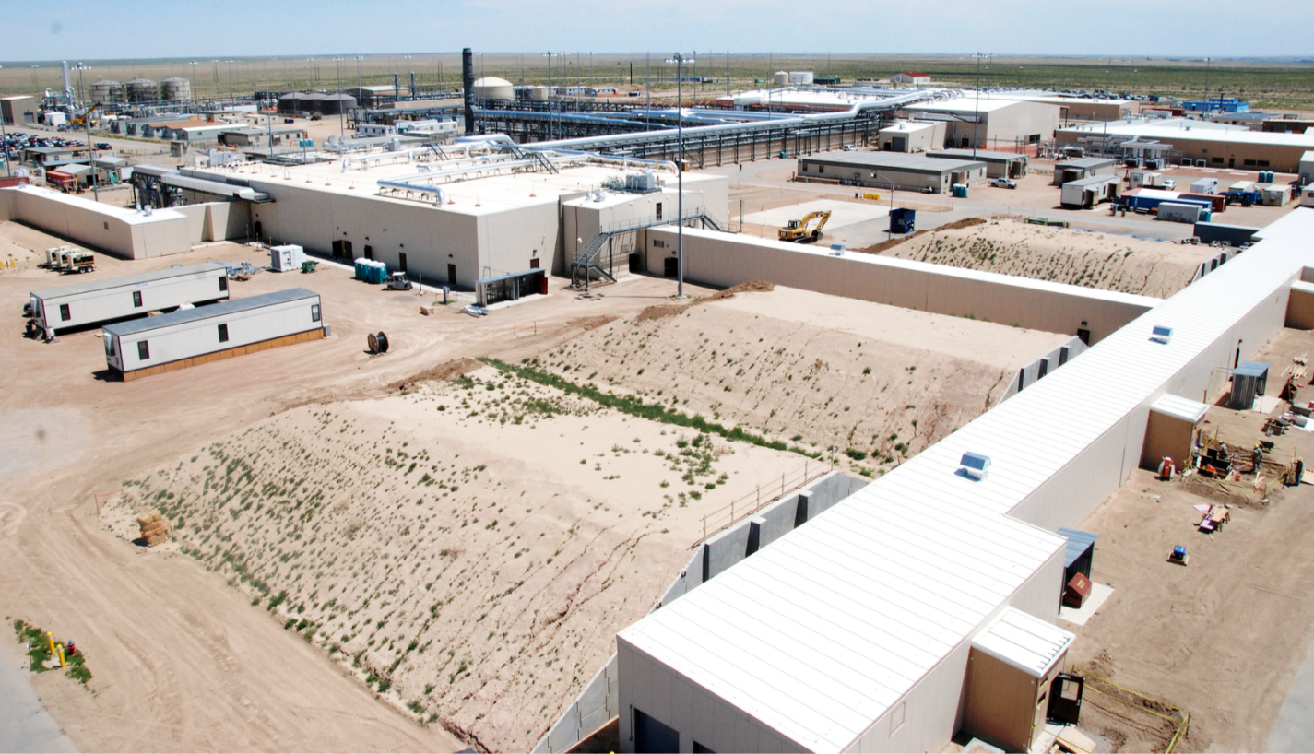
Pueblo Chemical Agent-Destruction
Pilot Plant (PCAPP)
Biotreatment Area
Agent Filtration Area
Automated Guided Vehicle Corridor
Agent Processing Building
Enhanced Reconfiguration Building
Munitions Service Magazine Corridor
Munitions Service Magazine
5
Notes:
Pueblo construction was declared complete on 12 December 2012. This overhead view highlights several key areas of the plant, and gives you a good idea of how spread out the Pueblo plant is; in fact, the pilot plant comprises nearly 85 acres.
Systemization was completed in late August 2016 and the facility began chemical agent destruction operations on 7 September 2016..
Photo: June 2012

Slide 6
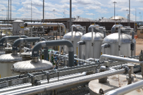
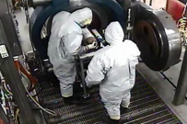

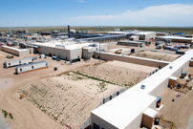
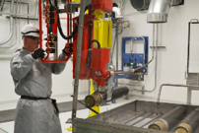
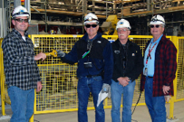
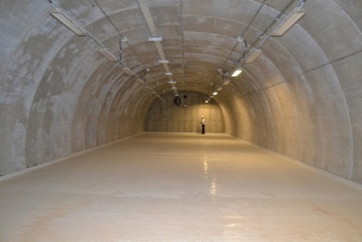
Pueblo Chemical Agent-Destruction Pilot Plant Current Status
Destruction Technology: Neutralization/
Biotreatment
Explosive Destruction System First Campaign Complete: Feb 11, 2016
Pilot Plant Construction Status: 100% Complete
Pilot Plant Operations Began: Sep 7, 2016
Pilot Plant Systemization Status: 100% Complete
Anticipated End of Destruction Operations: 2020
Notes:
Here is a snapshot of the Pueblo plant’s current status.
As the video mentioned, we completed the initial destruction of problematic weapons in Colorado in February using the Explosive Destruction System, and I’ll be showing you our current destruction numbers in the next slide.

Slide 7
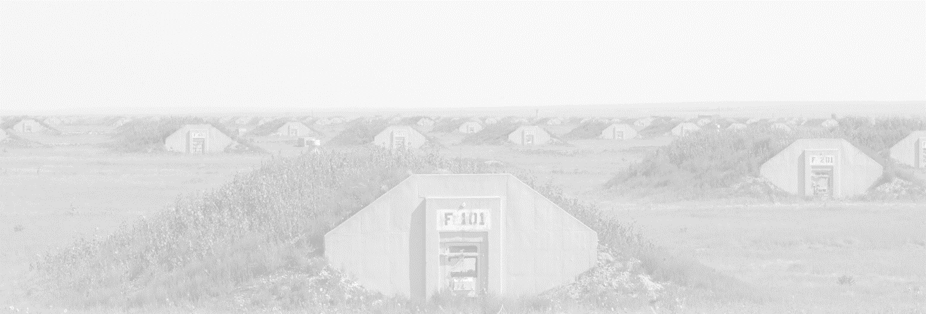
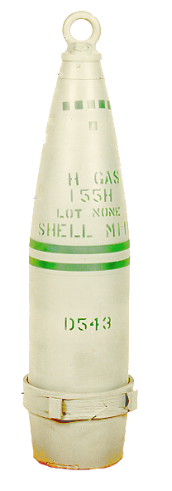
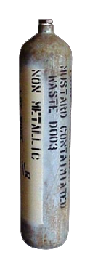
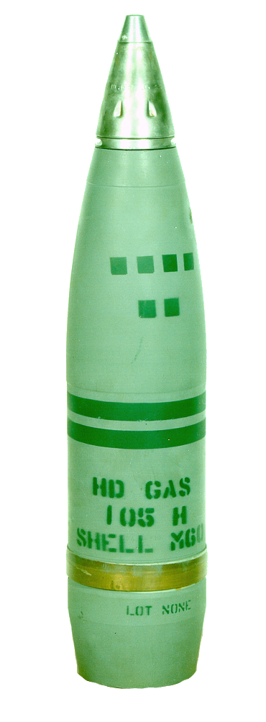
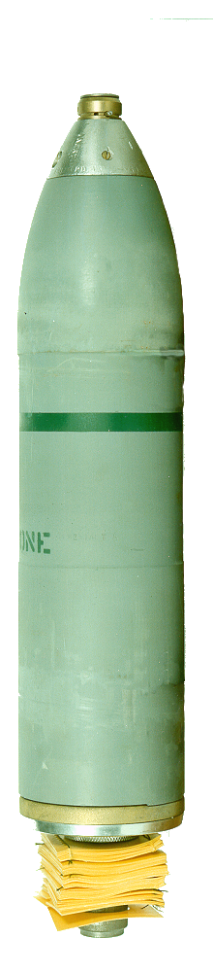
PCAPP Stockpile Destruction Progress (EDS & Main Plant)
Munition | Agent Type | Destroyed As of 13 November 16
4.2-inch Mortar | HD | 42
4.2-inch Mortar | HT | 46
105mm Projectile | HD | 265
155mm Projectile | HD | 6,344
DOT Bottles* | HD/HT | 11
Total |  | 6,708
26.8”
25”
155mm
Projectile
DOT
Bottle*
21”
24”
4.2-inch
Mortar
105mm
Projectile
* Department of Transportation Bottles are not included in the original declaration quantities, since they contain samples/waste from declared stockpile.
Notes:
The PCAPP Explosive Destruction System, known as PCAPP EDS, has completed its initial campaign, which was to destroy 560 problematic munitions and DOT bottles.
It is now in what we call “warm storage” until the plant begins operating and generating rejects. You’ll recall from the video that “rejects” are items that present a challenge to safely disassemble using the automated systems in the main plant.

Slide 8
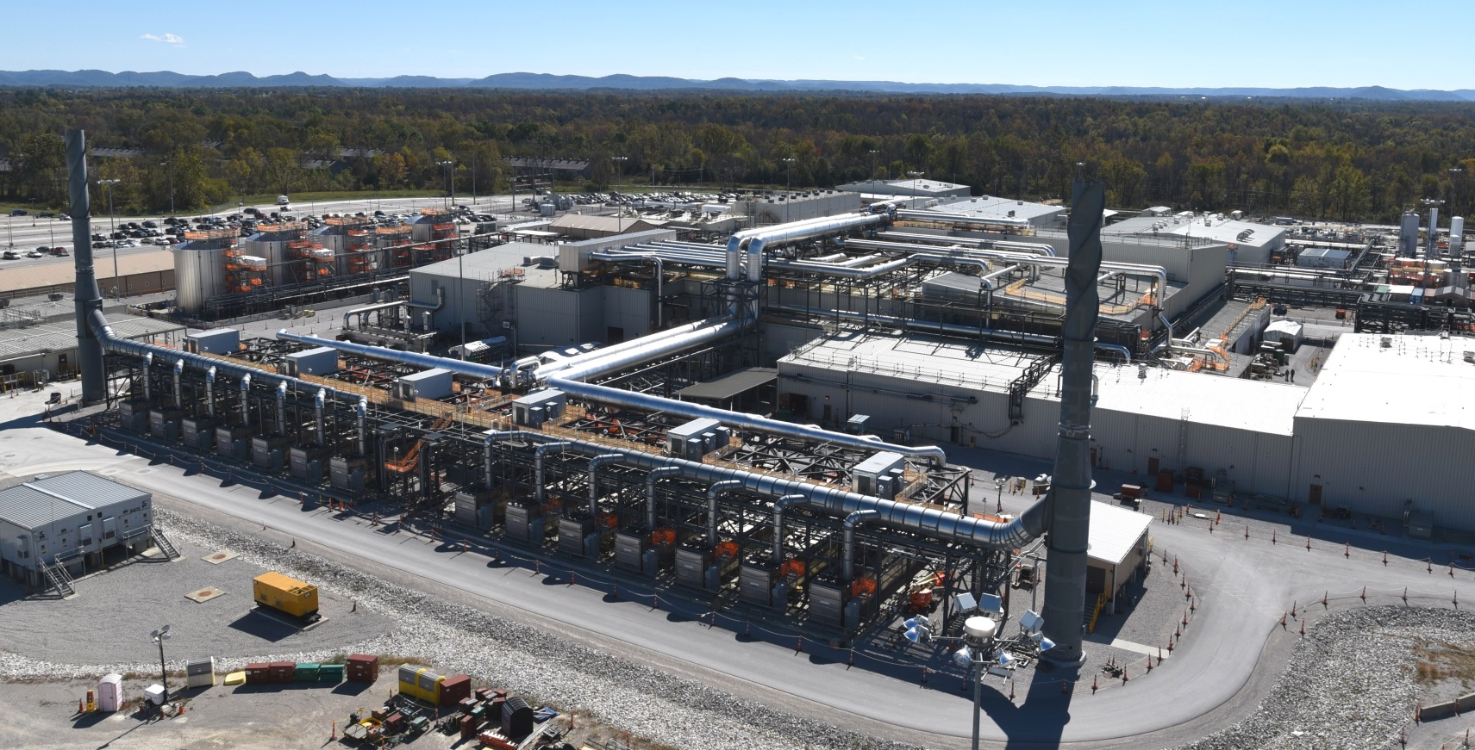
Blue Grass Chemical Agent-Destruction Pilot Plant (BGCAPP)
Laboratory Building
Supercritical Water Oxidation
Processing Building
Control and Support Building
Utility Building
Hydrolysate Storage Area
Munitions Demilitarization Building
Container Handling Building
MDB Filter Area
Notes:
This overhead view highlights several key areas of the Blue Grass Chemical Agent-Destruction Pilot Plant; the pilot plant comprises approximately 19 acres.
Blue Grass is in the middle of construction. As shown here, the facility is 99% complete – we say “essentially” complete - and systemization is 51% complete.
The Blue Grass main plant is scheduled to begin destruction operations in April 2020.
Photo: April 2016

Slide 9
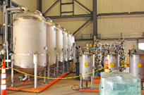
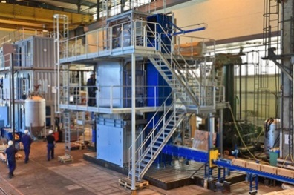

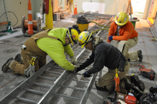
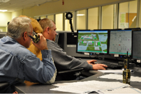
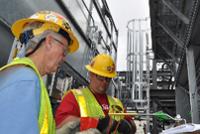
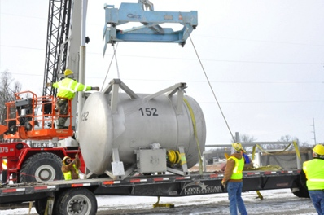
Blue Grass Chemical Agent-Destruction Pilot Plant Current Status
Destruction Technology:
Neutralization/
Supercritical Water Oxidation
Static Detonation Chamber Operations Begin: Under Review
Pilot Plant Construction Status: 99.6% Complete
Pilot Plant Operations Begin: Under Review
Pilot Plant Systemization Status: 62% Complete
Anticipated End of Destruction Operations: 2023
As of October 28, 2016
Notes:
Here we have the current status of the Blue Grass plant. Construction is essentially complete while systemization is over the 59 percent mark and gaining momentum every day.
To maintain progress, we’ve always employed a waterfall approach to the stages – systemization overlaps construction. So, while construction continues, installed equipment and systems are transferred to the start-up team to begin the systemization process.

Slide 10
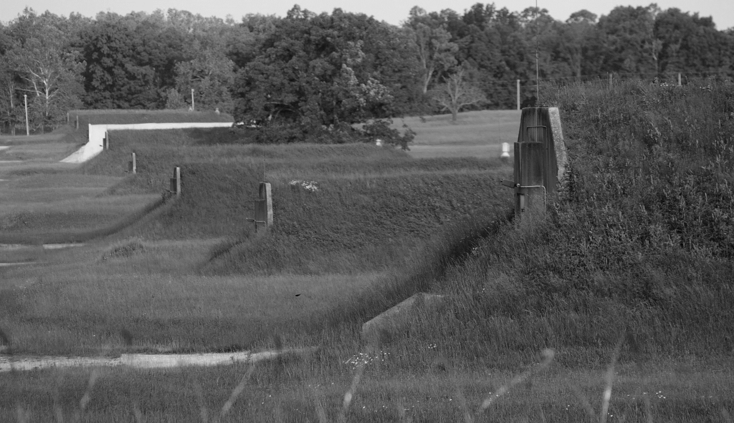
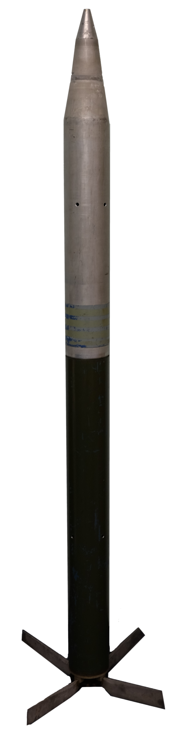
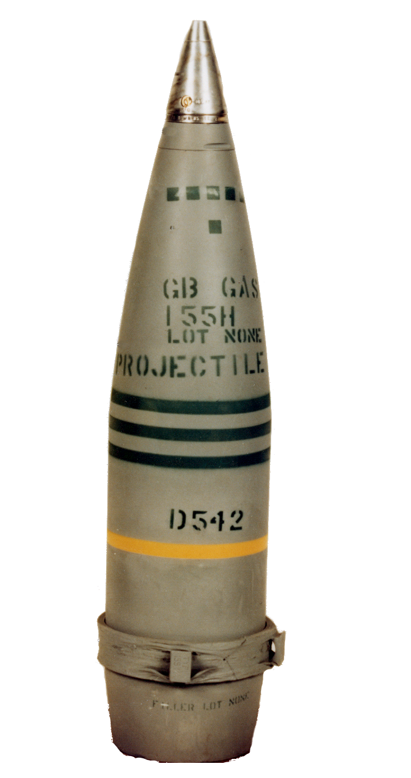
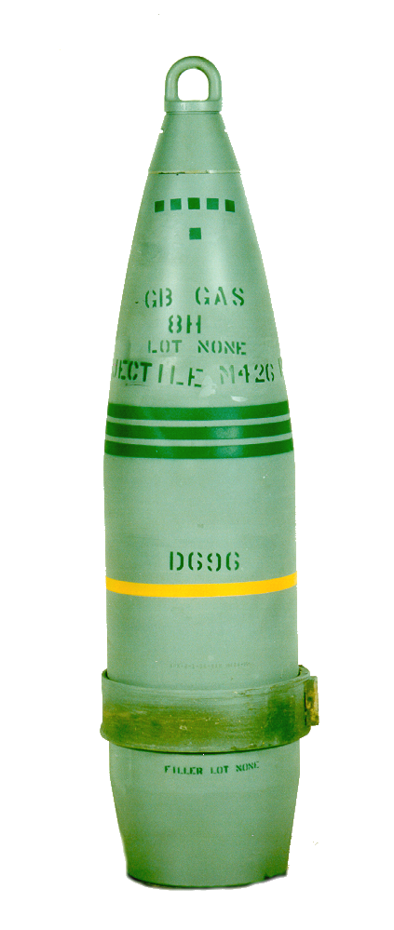
Blue Grass Chemical Weapons
Inventory
Munition | Agent Type
M55/M56 Rocket | GB
M55/M56 Rocket | VX
8-inch Projectile | GB
155mm Projectile | VX
155mm Projectile | H
M55/M56
Rocket
78”
8-inch
Projectile
155mm
Projectile
35.1”
26.7”
Notes:
As was mentioned previously, while Blue Grass has the smallest stockpile inventory – some 523 tons – it contains a challenging mixture of mustard and nerve agent configured in rockets and artillery projectile.
All of the nerve agent – VX and GB – will be destroyed by neutralization followed by Supercritical Water Oxidation. The mustard agent inventory will be destroyed by the Static Detonation Chamber, or SDC, that is being purchased and installed at Blue Grass over the next two years.
A significant number of mustard projectiles in the Blue Grass stockpile contain the oldest mustard remaining in the inventory. Similar projectiles - manufactured in the same lots as those stored at Blue Grass - were processed at the disposal facility in Utah. These projectiles showed large amounts of agent solidification, called “heel.” Problems were also encountered with degraded bursters and burster wells that made disassembly of the munitions extremely problematic.
After a good deal of study we elected to employ the SDC to meet this particular challenge.

Slide 11
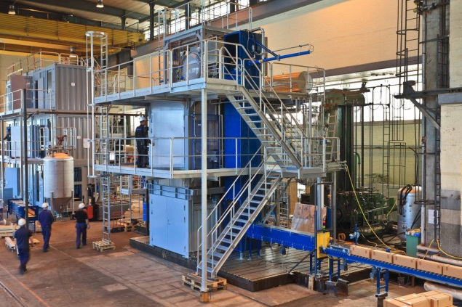
Anniston Field Office
Located at Anniston
Army Depot, Alabama
Staff represents more than 60 years of chemical demilitarization expertise
Supports both BGCAPP and PCAPP
Anniston’s Static Detonation Chamber will be used to:
Train BGCAPP’s SDC personnel
Dispose of PCAPP uncontaminated energetics
Notes:
ACWA’s acquisition of the Anniston Field Office at the site of the former Anniston Chemical Agent Disposal Facility provides our program with a huge benefit. Not only does it make available to us the use of their Static Detonation Chamber on which we can train our Blue Grass team, but it is also a safe and cost-effective way to dispose of the non-contaminated energetics or explosive components of some 780,00 munitions from the Pueblo stockpile.
Most importantly, Anniston allows us to tap into the more than 60 years of chemical demilitarization experience possessed by Site Project Manager Tim Garrett and his staff.

Slide 12

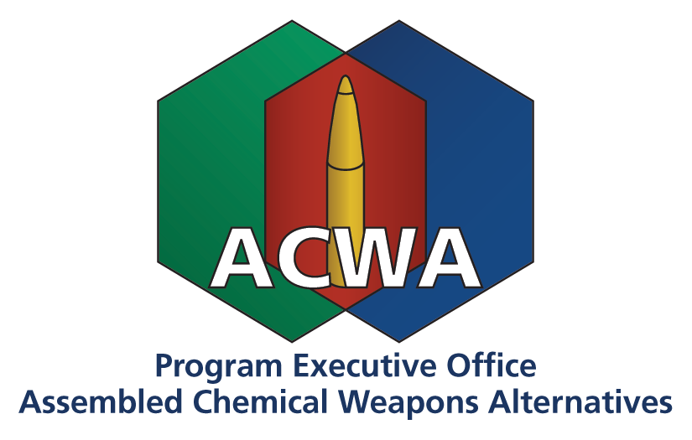
Program Stakeholders
Organisation for the Prohibition of Chemical Weapons
Congress
National Security Council
Office of the Secretary of Defense
Department of the Army
U.S. Army Materiel Command
U.S. Army Corps of Engineers
U.S. Army Contracting Command
U.S. Army Acquisition Support Center
Department of State
Department of Energy/National Laboratories
Department of Health and Human Services
Citizens Groups
ACWA Employees
Contractor Workforce
Defense Industry
National Academies of Engineering, Sciences & Medicine
Environmental Protection Agency
Federal Emergency Management Agency
States and Counties
Joint Munitions Command
Edgewood Chemical Biological Center
U.S. Army Chemical Materials Activity
Notes:
The national importance – and complexity – of the chemical demilitarization program in general and the ACWA program in particular are aptly illustrated here in the number and variety of organizations with whom we work to achieve one goal: the safe and environmentally sound destruction of the chemical weapons stockpiles in Colorado and Kentucky.

