Slide 1
Leading Organizational Change: Five Important Concepts
Creating High Performance Organizations
Dr. Robert Ginnett

Slide 2
Introduction
Organizational Change and Development is a HUGE concept.
We are going to look at five critical concepts.
We will also link this to the critical variables in creating HPOs.

Slide 3
Concept One
The sigmoid curve.
Charles Handy

Slide 4
Topic Two
Organizational Structure
Two Extremes of Structure
What about HPOs?

Slide 5
Topic Three
How BIG change happens
How we wish it would happen
How we think it happens
How it really seems to work

Slide 6
Topic Four
What are the Organizational Systems that will impact change at BARDA?
Reward Systems
Education Systems
Information Systems
Control Systems

Slide 7
Topic Five
Never forget ---
“The Law of
Unintended Consequences”

Slide 8
Creating High Performance Organizations
HPOs in today’s world
An Awareness Session
Dr. Robert Ginnett

Slide 9
In a complex, turbulent environment, HPOs are designed to support--
TEAMS

Slide 10
Teams are complex.
Information Systems
Task
Effort
Strategy
Skills & Abilities
Interests & Motivations
Build the team !
Education Systems
Authority
Composition
Satisfy stakeholders ! !
Group Dynamics
Interpersonal Behavior
Reward Systems
Values & Attitudes
Individual satisfaction !
Knowledge & Skills
Norms
Control Systems

Slide 11
General Systems Theory
Output
Process
Input

Slide 12
Typical Interventions
Output
Process
Input

Slide 13
What’s the problem?
Output
HINT:
What does your physician do?
Process
Input

Slide 14
What should we be doing?
Output
Process
DIAGNOSE
Input
TREAT

Slide 15
Output
Process
Input

Slide 16
Output
HPO
Process
What’s going on?
Individual Characteristics
Input
Team Factors
Organizational Systems

Slide 17
1
HPO
P-1 Effort
Group Dynamics
I
I-1 Motivations & Interests
Group Dynamics
Interpersonal Behavior
T
T-1 Team Task
Authority Dynamics
O
O-1 Reward Systems
Control Systems

Slide 18
2
HPO
P-2 Know-ledge & Skills
Group Dynamics
I
I-2 Skills & Abilities
Group Dynamics
Interpersonal Behavior
T
T-2 Team Composition
Authority Dynamics
O
O-2 Education Systems
Control Systems

Slide 19
3
HPO
P-3 Strategy
Group Dynamics
I
I-3 Values & Attitudes
Group Dynamics
Interpersonal Behavior
T
T-3 Team Norms
Authority Dynamics
O
O-3 Information Systems
Control Systems

Slide 20
4
HPO
P-4 Group Dynamics
I
I-4 Interpersonal Behavior
T
T-4 Authority Dynamics
O
O-4 Control Systems

Slide 21
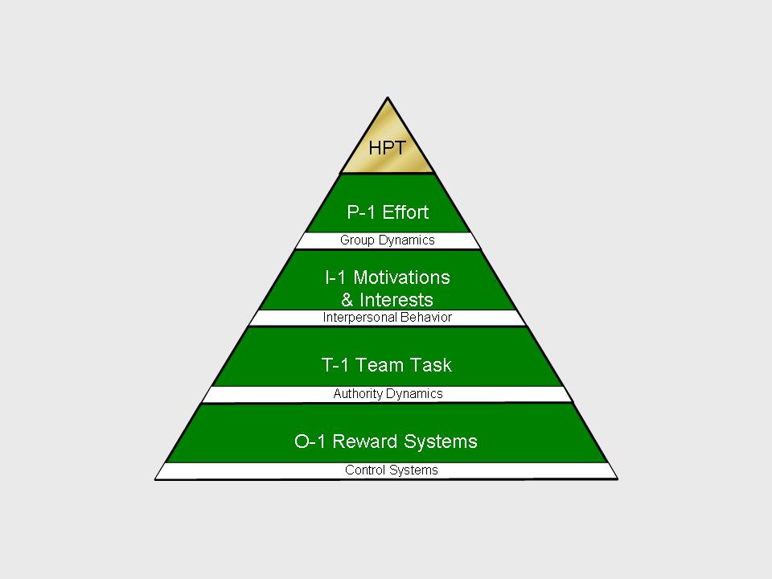
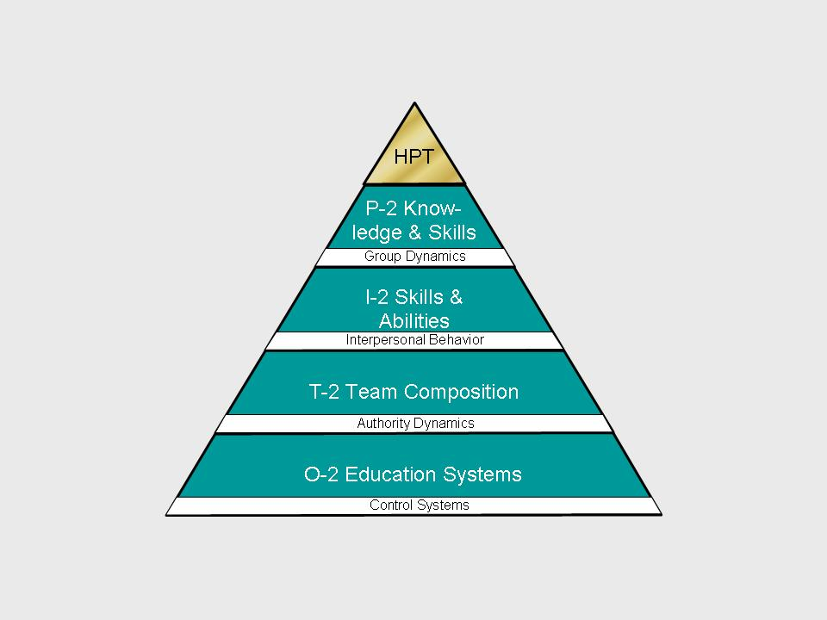
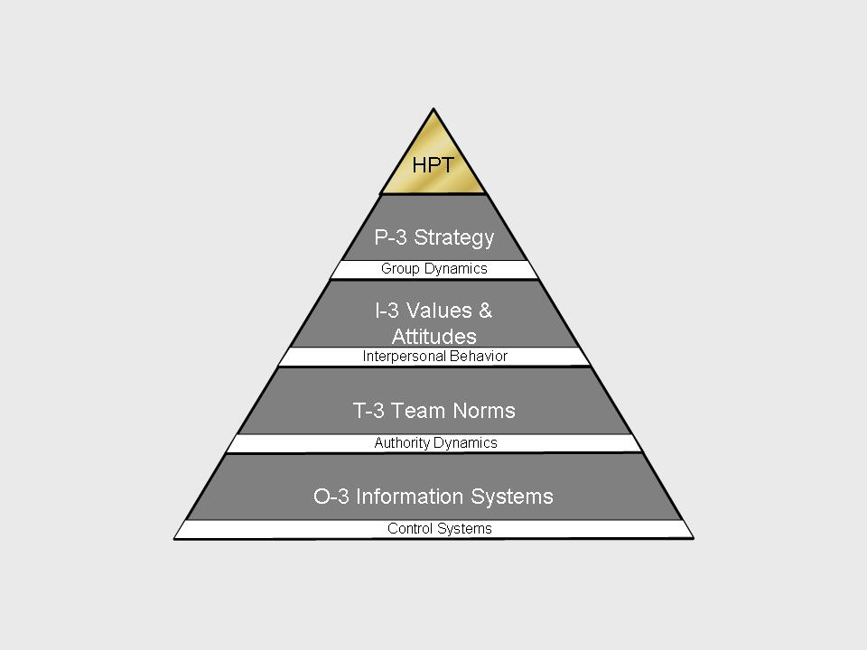
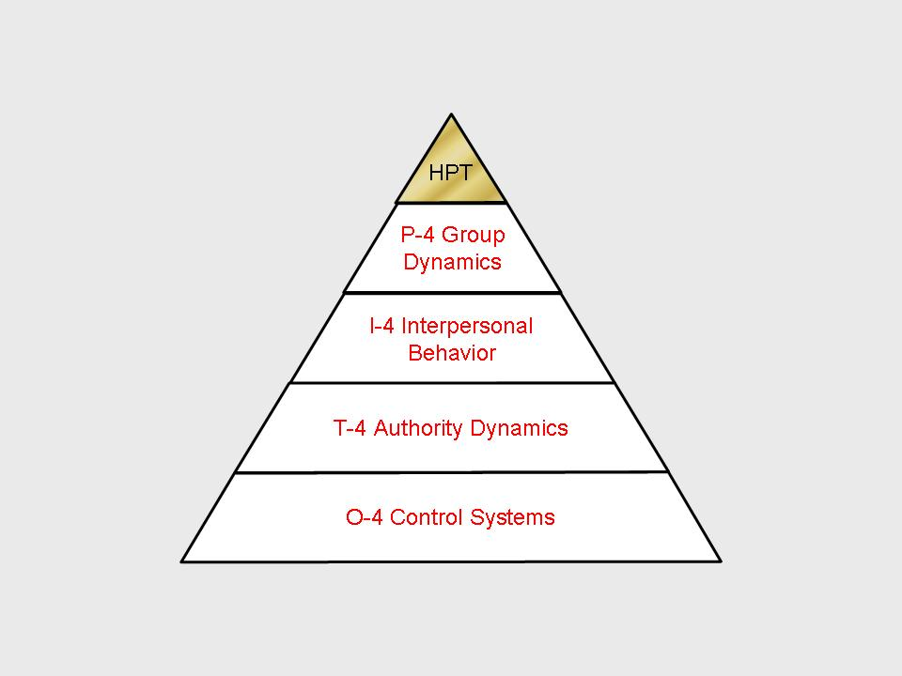
1
2
3
TLM
4
© 2011 Robert C. Ginnett, Ph.D.. All rights reserved

Slide 22
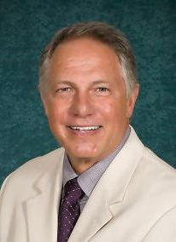
Avoir l'esprit de l'escalier
robert@ginnettleadership.com
719 440-5560
www.GinnettLeadership.com

