Slide 1
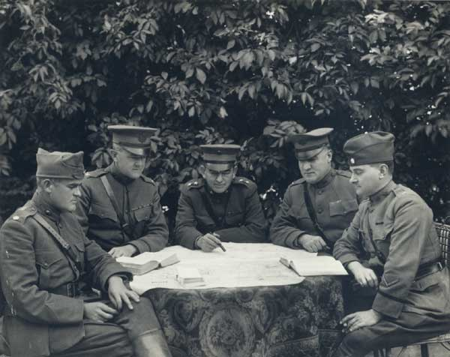
Formulating Strategy

Slide 2
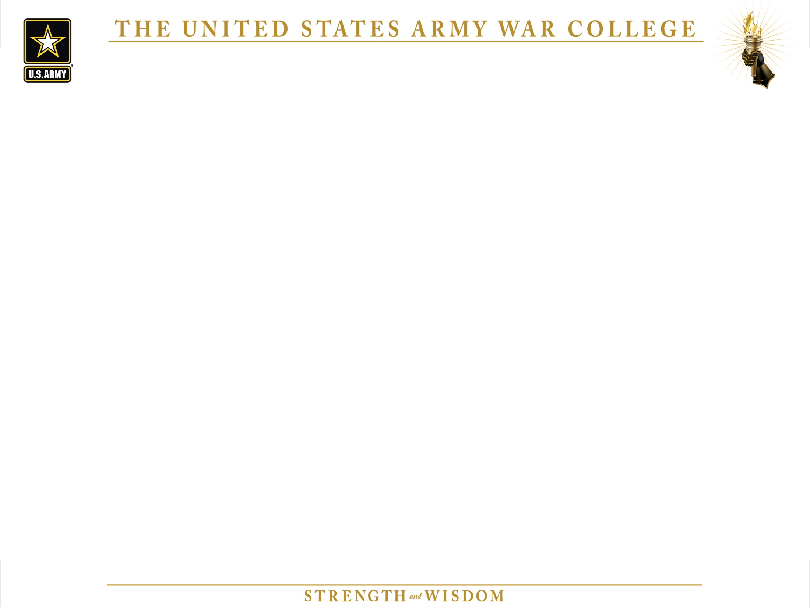
Formulating Strategy
Analyze origins of strategy.
Analyze the ideas of operational design.
Understand the ideas of operational art.
Evaluate the use of the operational design methodology to help understand, synthesize, and develop an approach for complex, ill-structured problems.

Slide 3
UNCLASSIFIED
Strategic Planning Construct
National Security Strategy * – National Priorities
National
Strategies
DSG**
Quadrennial Defense Review *
Strategy Adjustments
National Military Strategy – Strategic Direction
CSDJF**
Employ the Force
Manage the Force
Develop the Force
Unified Command Plan – Combatant Command Missions & Responsibilities
Strategic Planning
Documents
Guidance for Employment of the Force* –
DoD Planning Guidance & Priorities
Defense Planning Guidance –
Priorities & Risk for the Future Force
GFMIG
GFMAP
Joint Strategic Capabilities Plan –
CJCS Direction for Planning/Apportionment
Operational & Regional Strategies & Plans
- Theater Strategies – Derived from UCP Missions & Responsibilities
- Global / Theater Campaign Plans – Focus on Global / Theater End States
  Contingency Plans - Detailed Branches / Sequels to Campaign Plans
- Campaign Support Plans – Priorities/tasks to support CCMD TCPs
Force Development Products
Service / SOCOM POMS & Plans
DoD Support to Strategic Analysis
Strategic /Operational Execution Documents
CJCS Program Assessment –
Appraisal of Programs & Budgets
Comprehensive Joint Assessment – Integrated Global/Regional ends-ways-means-risk analysis
IPLs
CJCS Risk Assessment –
Military & Strategic Risk Assessment
Joint Strategy Review
CJCS Program Recommendation
(Capabilities / Programs / Budgets)
Assessment/ Feedback Mechanisms
LEGEND
* POTUS & SECDEF Document
**Defense Strategic Guidance (DSG)
**Chairman’s Strategic Direction to the Joint Force (CSDJF)
POTUS
SECDEF
CJCS
CCDR / SERVICE
Notes:
[Slide from JS J-5.]
This Slide is a pictorial “Strategic Planning Construct” showing many strategic guidance documents. Based on time, the lesson’s focus is the top half of the slide.
- Defense Management (DM) will continue, specifically regarding the Defense Planning Guidance (DPG), Chairman’s Risk Assessment (CRA), Joint Strategy Review (JSR), and the Chairman’s Program Recommendation (CPR).
- The complementary Joint Strategic Planning System (JSPS) and Planning, Programming, Budgeting, and Execution System (PPBES) have no parallel in other agencies or at the National Security Council (NSC).
The two systems address the four DoD core competencies: strategic direction, force employment, force management, and force development.
Joint Assessment: A joint assessment is an analytical activity based on
unbiased trials conducted under controlled conditions within a representative environment, to validate a concept, hypothesis, discover something new, or establish knowledge. Results of an assessment are reproducible and provide defensible analytic evidence for joint force development decisions. Assessments and wargames provide the means to determine the efficacy of proposed capability to challenges, problems, and issues facing CCMDs, services, agencies, and MNFs

Slide 4
Formulating Strategy
Where does your strategic guidance come from?
What additional guidance do you get?
What laws/rules/regulations must you follow?

Slide 5
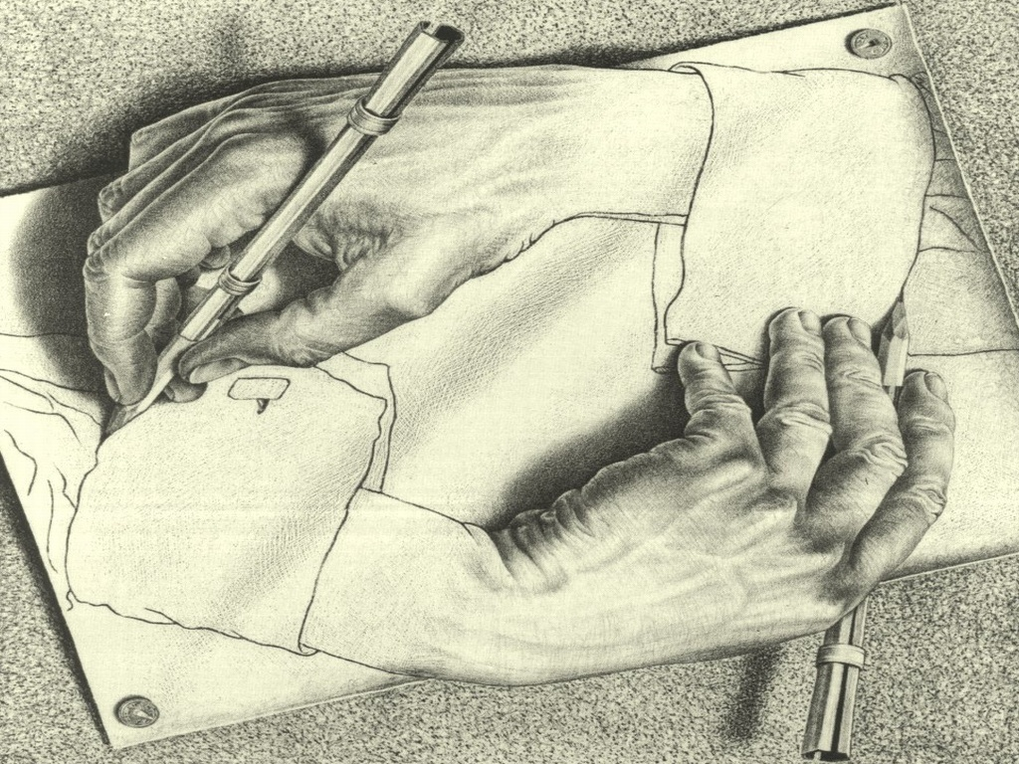
Operational Art and Operational Design
Operational Design

Slide 6
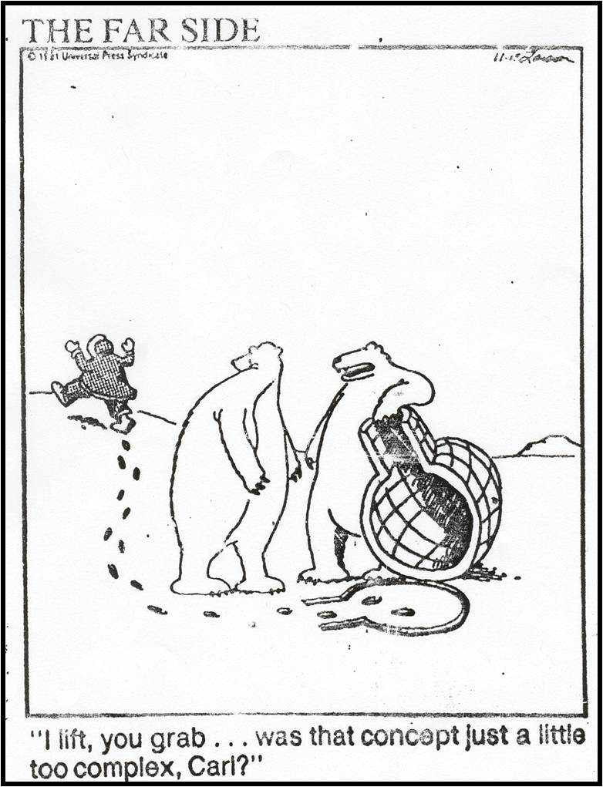
Operational Design
Why Design Thinking?
Increasing VUCA environment often results in less familiar and more ill-structured problems and less precise guidance.
Recent history of tactical excellence yet strategic failure – due largely to a failure to define the problem correctly and to adapt as the environment changed.
Need for a more adaptable military culture.
Notes:
VUCA – Volatile, Uncertain, Complex, Ambiguous

Slide 7
“Wicked Problems”
“Policy problems cannot be definitively described. Moreover, in a pluralistic society there is nothing like the indisputable public good; there is no objective definition of equity; policies that respond to social problems cannot be meaningfully correct or false; and it makes no sense to talk about 'optimal solutions' to these problems...Even worse, there are no solutions in the sense of definitive answers."
No definitive formulation
No stopping rule
Solutions are not true or false, but good or bad
No immediate or ultimate test of a solution
Every solution is a “one-shot” operation; every attempt counts significantly
No exhaustive set of possible solutions; no well-described operations
Every one is essentially unique
Can be considered a symptom of another problem
Existence of discrepancy can be described in numerous ways
The planner has no right to be wrong
Rittel and Webber, 1973
(in Camillus, 2008)
Notes:
Background: Rittel and Webber coined the term in the context of problems of social policy, an arena in which a purely scientific-rational approach cannot be applied because of the lack of a clear problem definition and differing perspectives of stakeholders.^{[7]} In their words, "The search for scientific bases for confronting problems of social policy is bound to fail because of the nature of these problems...Policy problems cannot be definitively described. Moreover, in a pluralistic society there is nothing like the indisputable public good; there is no objective definition of equity; policies that respond to social problems cannot be meaningfully correct or false; and it makes no sense to talk about 'optimal solutions' to these problems...Even worse, there are no solutions in the sense of definitive answers.“ Rittel and Webber's (1973) formulation of wicked problems specifies ten characteristics, perhaps best considered in the context of social policy planning.
NEXT SLIDE: Complexity—the reason for design.

Slide 8
How can we think through the complexity?
Know that the outcome of actions cannot be determined with certainty
Know that there will almost always be unintended consequences
Understand that the environment and the problem are dynamic
Understand that we must affect the future environment; we can’t affect the current environment
Understand that there is no “right” answer; just varying degrees of better or worse
Know that you can’t understand the environment until you act on it…and then you must continually act and adapt
Understand that there are no models because this environment has never happened before

Slide 9
Design Fundamentals
The Goal: deeper and broader understanding (of the environment and the problem(s).
Apply critical and creative thinking.
Address the right problem.
Adapt to dynamic conditions—(tactical strategic levels).

Slide 10
What does Design do?
It is an approach to planning, not a fundamentally new method of warfighting.
It supplements, rather than supplants, established planning processes (like JOPP and MDMP) (what are your established planning processes?).
It tends to use systems-oriented, conceptual, but logical lines of operations for operational design.
It has most applicability for planning at the strategic and operational levels.

Slide 11
What Design is not:
A replacement for or better than JOPP/MDMP. Is not a process.
A magical or esoteric way of thinking.
Something that necessarily saves you time.
Will not save you if you are not a critical and creative thinker.

Slide 12
Operational Art and Operational Design
Operational Design – The conception and construction of the framework that underpins a campaign or major operation plan and its subsequent execution. (JP 1-02, OCT 2013).
Operational Art --The cognitive approach by commanders and staffs—supported by their skill, knowledge, experience, creativity, and judgment—to develop strategies, campaigns, and operations and organize and employ military forces by integrating ends, ways, and means.(JP 1-02, OCT 2013).
Joint Operational Planning Process--An orderly, analytical process that consists of a logical set of steps to analyze a mission, select the best course of action, and produce a joint operation plan or order. Also called JOPP. (JP 1-02. OCT 2013).
Notes:
Operational Design provides the context through which Operational art is applied.
Operational Art translates Design into action (objectives, tasks, effects, etc.)
Planning and doctrine without design provides a common understanding of the irrelevant.
Design without planning and doctrine cannot effectively be translated into effective action by large, complex organizations and diverse stakeholders.
In general, the terms have been related but not identical. The focus of discussion and writing on design during the past three years has been on the critical and creative thinking and learning required to understand complex operational environments and ill-defined problems facing the commander. Such understanding should facilitate early development of a broad operational approach that can guide the more detailed planning process. Operational design is a construct that joint doctrine has used since 2002 to encompass various elements of operational design (previously called facets of operational art) that planners have applied to develop a framework for a campaign or major operation.3 However, joint doctrine’s explanation of operational design has focused more on the details of each element (such as center of gravity analysis) than on the critical and creative thinking that must precede the elements. The term operational art, described later, embodied the creative and visionary application of the elements.
The community’s recent work to describe the importance of design’s early critical and creative thinking has helped refocus joint doctrine’s operational design. The (August 2011) JP 5-0 incorporates the generic design methodology as a way to improve the JFC’s and staff’s early understanding through what some call “conceptual planning” before planners move too quickly to detailed planning.

Slide 13
Operational Art and Operational Design
Design vs Planning?
DESIGN
Problem Setting (Framing)
Conceptual—Tabula Rasa
Questions Assumptions & Methods
Develops Understanding
Paradigm-Setting
Precedes Planning & Preparation
Complements Execution & Assessment
Commander-Centric Dialogue
Supported by the Staff
Supports and is supported by Joint Operation Planning Process (JOPP)
Mostly art
PLANNING
Problem-Solving
Physical & Detailed
Procedural
Develops Products for Execution
Paradigm-Accepting
Patterns & Templates Activities
Staff-Centered Process
Mostly science

Slide 14
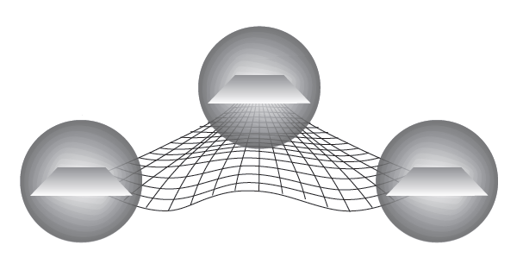
The Design Activities
PROBLEM
FRAME
ENVIRONMENTAL
FRAME
Design Concept
OPERATIONAL
APPROACH
FRAME THE ENVIRONMENT
What is the context in which
the design will be implemented?
    What’s going on?
    Why has this situation developed?
    What does it mean?
    What’s the natural tendency of the environment?
FRAME THE PROBLEM
What problems should be addressed
and what must be acted upon?
  What needs to change?
  What doesn’t need to change?
  What are the strengths and weaknesses of the actors?
  What are the opportunities and threats?
  What conditions need to exist for success?
FRAME THE OPERATIONAL APPROACH
How can we solve the problem?
  How do we go from existing conditions to desired conditions?
  What tensions exist between the two?
  What else can happen?
  What are the risks?
DESIGN CONCEPT
- Description of the Operational Environment
- The problem statement
- A Mission Narrative
- Commander’s description or graphic of the Operational Approach
- Commander’s initial Intent and Planning Guidance
Notes:
This slide portrays the design methodology (Army or Joint), in a comprehensive, practical and usable way. Students should be able to relate to this slide and understand that although we may usually begin with frame the environment, you could (and perhaps should) be doing all three at once (at lease mentally)—particularly once the initial design effort has been accomplished and you have moved on to the more “iterative” portion of design.

Slide 15
Design through Planning and Execution
A design approach allows the organization to learn through understanding and action by maintaining divergent thinking while also converging to develop and execute detailed plans that enable action.
The commander and staff develop better understanding of the environment and of the problem as the campaign is executed, and adapt the operational approach based on that increasing understanding.
Divergent
Difference
between
understanding
and reality
Plans
&
Orders
Convergent
Plans
&
Orders
Plans
&
Orders
change
Convergent
change
Convergent
Planning takes guidance from the commander and, through the planning process, converges to produce plans and orders to execute actions to have effects of the environment.
Notes:
Design is iterative. It is necessary to constantly review the OE to see if it has changed (or if the initial analysis was flawed). However, too much divergent thinking will lead to paralysis—at some point you must converge and make an executable plan—but understand the OE, and consequently the problem and the plan to address the problem, may change.
Used for both deliberate and crisis action planning (chart on wall).
Theater Strategic level is significantly different than Operational/Tactical. When you get the plans & orders wrong at the BDE level, it is significantly less impact than when it happens at the theater level (blood and treasure). Examples?

Slide 16
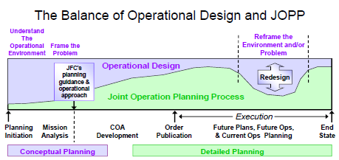

Develop an Operational Approach
Define The Problem
Execute
ART
SCIENCE
Notes:
Use as another way of showing the continuous relationship between JOPP and Operational Design
Joint operation planning blends two complementary methods. The first is the Joint Operation Planning Process... .
[The Joint Operation Planning Process] is an orderly, analytical planning process, which consists of a set of logical steps to analyze a mission, develop, analyze, and compare alternative COAs, select the best COA, and produce a plan or order.
The second method is operational design, the use of various design elements in the conception and construction of the framework that underpins a joint operation plan and its subsequent execution. The operational design elements are used throughout [the Joint Operation Planning Process] and are fundamental to that process.
A primary consideration for a supported [combatant commander] during mission analysis is the national strategic end state ...
The supported [combatant commander] typically will specify a military end state. While it will mirror many of the objectives of the national strategic end state, the [military] end state may contain other supporting objectives and conditions. ...
JFCs include a discussion of the national strategic end state in their planning guidance. This ensures that joint forces understand what the President wants the situation to look like at the conclusion of US involvement. The [combatant commander] and subordinate JFCs typically include the military end state in their commander's intent statement. (JP 5-0, Chapter III, 12. b.)
Slide if from the JS J-7 Planner’s Handbook for Operational Design, Oct 2011
http://www.dtic.mil/doctrine/docnet/courses/planning/planning.htm

Slide 17
What is your “design” process?

Slide 18
Operational Design
Environmental Frame
What are the US interests in the region?
What are the key historical and cultural aspects of the environment?
What are the key relationships and key actors in the region?
What other actors have interests in the region that may present opportunities or challenges?
What is causing conflict among the actors internal to and external to the region?
What conditions are likely to emerge in the region if parties outside the region take no action?
What specific guidance have we been given? Implied guidance? Is there any conflicting guidance?
What are US desired conditions for the region in five years? Ten years?
What are the desired conditions in the region of other actors?

Slide 19
Systems Perspective: A way to Help Frame the
Operational Environment
Political
Military
Economic
Social
Information
Infrastructure
Nodes: Elements of a system that represent a person, place, or thing.
Links: Elements of a system that represent a behavioral, physical, or functional relationship between nodes.
Notes:
The intent of this slide is to introduce the PMESII construct that we will use throughout TSC as we develop and analyze the operational environment.
VIDEO: After you explain this slide, click on the video link to show a 3.5 minute TED video which describes using links and nodes to analyze any complex system--at the end of the video, the speaker addresses the complex “spaghetti” chart that was used to visualize the environment in Afghanistan:
http://www.ted.com/talks/eric_berlow_how_complexity_leads_to_simplicity

Slide 20
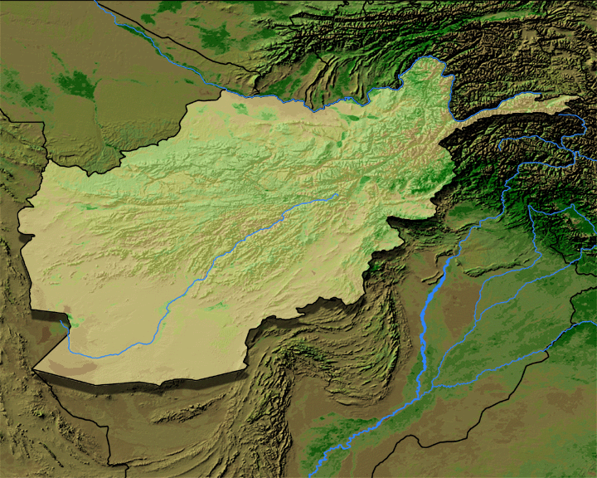
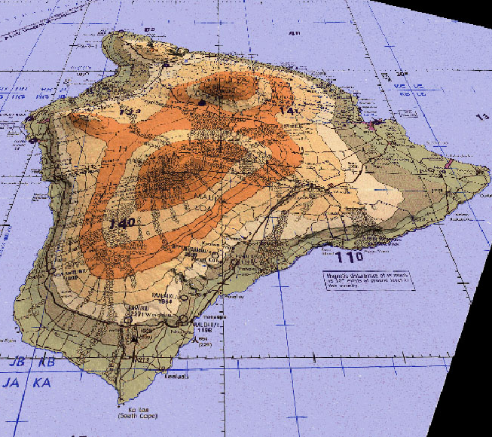

Understanding the Operational Environment
Assisting the conceptual leap from two dimensional
awareness to multi-dimensional understanding
Think “new”
Think “old way”
Systems Understanding
TROPIC LIGHTNING
TROPIC LIGHTNING
TROPIC LIGHTNING
PMESII Environment
K
K
K
K
Information
Vulnerabilities
Political
Military
Infrastructure
Links
Social
Strengths
Key Nodes
Economic
Weaknesses
Relationships
Time – Space awareness
Multi-dimensional situational understanding
Today’s adversary is a dynamic, adaptive foe who operates within a complex, interconnected operational environment.
Notes:
This slide continues or reinforces the argument that developing an Understanding of the Operational Environment is more than JIPB at the theater-strategic level.
This slide can also be used to engage in a discussion of the challenges associated with developing a broad, multi-dimensional understanding of the operational environment.
You might view this as tactical/operational on the left side and theater strategic/strategic on the right side.

Slide 21
Operational Design
Problem Frame
What needs to change?
What doesn’t need to change?
What are strengths and weaknesses of the various key actors?
What are the opportunities and threats?
What conditions need to exist for success?
How do we go from the existing conditions to the desired conditions?
What tensions exist between the current and desired conditions?
What tensions exist between our desired conditions and the adversary’s desired conditions?
What are the risks to going to the desired conditions?
What is the theater’s problem definition?

Slide 22
Design—Frame the Problem
Notes:
Walk through this chart or draw it on the board. The delta between the natural tendency of the OE and our desired tendency of the OE—understanding there are many different actors that will affect the OE for their interests—is where the tensions are. We can frame and better understand the problem if we properly identify and understand the tensions.

Slide 23
Operational Design
Operational Approach
How do we go from existing conditions to desired conditions?
What tensions exist between the two?
What distinguishable, measurable objectives will solve the problem we defined?
What is preventing us from accomplishing the objectives?
What opportunities might provide leverage to accomplish the objectives?
What means are available to us (DIME)?
What else can happen?
What are the risks of this strategic approach?
Is the problem we described achievable; if not how can we reframe it?

Slide 24
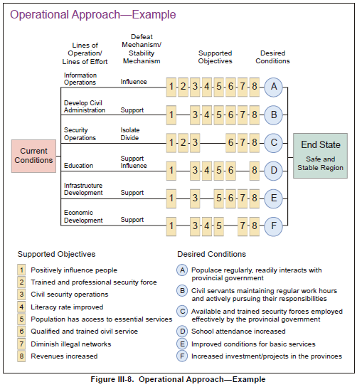
Notes:
Example of Op Approach from JP 5-0. Emphasize this is only one way—of many—to help visualize an operational approach. A narrative may work just as well, or, may accompany this diagram. Know your audience--using a diagram like this to explain an approach to non-military groups or people may be counterproductive; a narrative may be much more effective—particularly if using design to provide “options” at the SECDEF or POTUS level. This slide may be effective on a GCC staff but may not work to communicate an approach to someone on the Foreign Relations Committee.

Slide 25
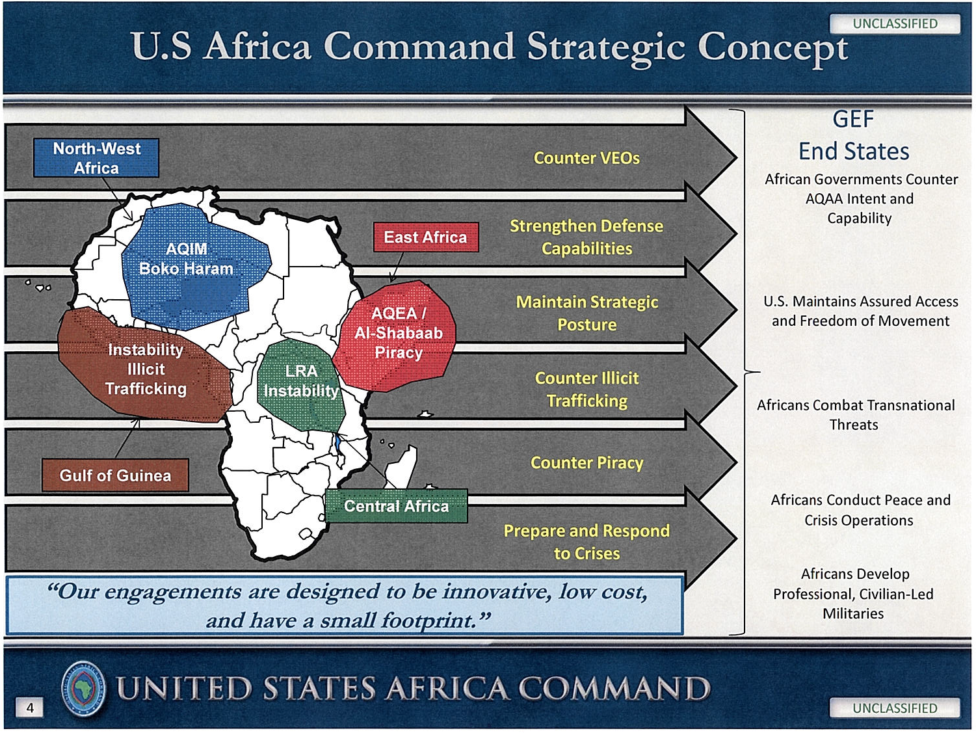
Notes:
Example of an approach with LOEs for USAFRICOM
This slide may be more effective in communicating to an audience less familiar with military methodologies.

Slide 26
ISAF Campaign Design (2011)
Lines of Effort
Operational Objectives
Ends
Protect the Population
Tier 1: Kandahar, Helmand, Khowst, Paktia, Paktika
Tier 2: Nagahar, Laghman, Kunar River Valley,
Kapisa, Wardak, Logar, Zabul, Uruzgan
Tier 3: Kabul, Heart, Mazar-e-Sharif, Jalalabad, and
Kunduz
Phase 3 ends
when the
insurgency is
defeated and
no longer able
to threaten the
survival of GIROA,
Afghanistan is
stabilized,
legitimate
governance
extends to local
levels, socio-
economic
programs benefit
the majority of
Afghan people,
and GIROA, with
ISAF in support, is
capable of
assuming the lead
for the provision
of security.
Partner with ANSF to secure population centers
Tailor force packages with mentor teams
Isolate INS from populations
Reduce INS intimidation, coercion, persuasion
Disrupt INS C2, operations, and sustainment
Enable Afghan National Security Forces
Accelerate ANA growth to 134,000 by Fall 2010. BPT
raise new target ceiling of 240,000 for ANA. BPT
raise target strength of ANP to 160,000. Increase
mentors, trainers, partners, funding, and GIROA
participation.
SECURITY
Recruit and train ANSF for COIN operations
Build sustainable capacity and capability in ANSF
Professionalize the force thru reform/accountability
WAYS
Strategic Communications/Civ-Mil Operations Cohesion
Neutralize Malign Influences
Malign actors are marginalized, illegitimate
governance denied, narcotic profiteering reduced,
foreign fighter networks disrupted, development
project extortion reduced and majority of
population views GIROA as legitimate.
Identify corruption; assist GIROA with detainee operations
Disrupt foreign sponsorship/support to INS in AFG
Prevent narco-state; deny narco-profiteering
Enhance Regional Cooperation
Support Extension of Governance
Ministries and sub-national governance partnered
with civil surge; Afghan reconciliation policy
established; local governance mechanisms allow for
reintegration; RoL and legitimate, responsive, and
accountable governance extended to the population.
STABILITY
Increase GIROA institutional capacity; enhance RoL
Enhance Provincial Reconstruction Teams
Support formal and informal sub-national structures
Support provision of essential services
GIROA revenue collection and resource distribution
mechanisms enhanced; infrastructure and road
networks bolster licit economy and increase
employment; incentive structures increase
stability in local communities.
Support Socio-Economic Development
Establish infrastructure and transportation networks
Increase employment opportunities/alternative livelihoods
Establish education programs
Solicit donors/establish Afghan Development Zones
Means
GIROA and ANSF
NATO-ISAF, Troop Contributing Naitons, UNAMA, Partners
Funding: International Community, Donors, UN, NATO, EU
FOR EDUCATIONAL PURPOSES ONLY, USAWC
Notes:
Example of an approach and LOEs from ISAF. What about Lines of Operation? Could they apply here?
Design helps turn identified problems into objectives, from which you can derive an operational approach.

Slide 27
Operational Design and Operational Art
Operational Art
DESIGN ELEMENTS
Termination
Military End State
Operational Art
Objectives
Center of Gravity
Arrangement of
O
Decisive Points
Capabilities in Time,
P
Space, and Purpose
E
National Strategic
Direct & Indirect Approach
Linkage of Ends,
J
End State
Ways, and Means
O
R
Systems Perspective
Joint Operation Planning Process
I
A
of the Operational
Course of Action
N
T
Environment
Lines of Operation/Effort
Commander
I
’
s
T
Operational Reach
Intent
O
Forces & Functions
Concept of
N
Anticipation
Operations
S
Culmination
Operational Art
Arranging Operations
More about the elements in the next lesson
Effects
Operational Art
Operational Art is how senior military leaders employ joint and combined forces to achieve objectives in the operational and theater strategic environments.
Notes:
This concluding slide links Op Art and Design together and sets up for the next class—”Elements of Operational Design.”

Slide 28
A Unified Theory of Policy-Strategy-Planning
Policy
Ends
Means
Processes
Ways
Strategy
Resources
Who
What
When
Where
Why
Campaign
Objectives (Goals)
WWWWW
Cdr’s Intent
Mission
Plng Guidance
Strategy Planning
Objectives
MoE (Outcomes)
Understand
Operational Env.
(What’s happening?)
Effects
MoP (Outputs)
Tasks
Define the
Problem
(What’s not
happening?)
Develop
Operational
Approach
(What should I be
doing about it?)
Operational Design methodology can help with policy formulation and strategy development as well as mission analysis.
Operational Design

Slide 29
Operational Art
Operational Art --The cognitive approach by commanders and staffs—supported by their skill, knowledge, experience, creativity, and judgment—to develop strategies, campaigns, and operations and organize and employ military forces by integrating ends, ways, and means.(JP 5-0, AUG 2011).
Traditional vs. modern views?

Slide 30
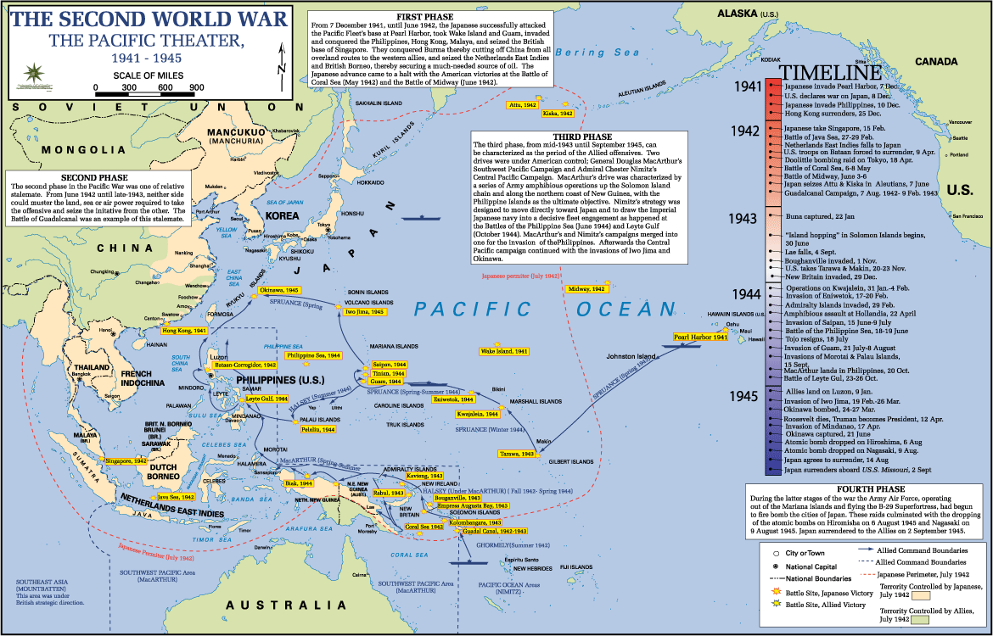
US in the Pacific in WWII: “Island Hopping.”
Notes:
Another Op Art example with a good timeline

Slide 31
Operational Art
Why Plan Campaigns…And Not a Single Operation?
………BECAUSE, THERE ARE CASES WHERE……..
YOU CAN’T GET IT ALL DONE IN A SINGLE OPERATION
Battle space/operating environment is too large to achieve a decision in one action.
Not enough Joint and/or Combined forces to overwhelm an enemy’s Center of Gravity in one stroke.
Mobility constraints (lift & throughput) may force sequential action.
The breadth (distance and context) of the operating environment prohibits a single operation
You don’t know enough yet to have sufficient confidence that your operations will achieve the desired result(s)
Campaign: A series of related major operations aimed at achieving strategic and operational objectives within a given time and space. (JP1-02)
Notes:
- Supports LO: Analyze the concepts of operational art and operational design.
- Supporting Readings: Schneider; Elkus.
- Discuss themes of the Schneider and Elkus articles.
QUESTION: These concepts nest nicely in set-piece conflicts that are well demarcated, but do they apply to modern conflicts and irregular warfare?
Factors contributing to the development, over time, of Operational Art (according to James Schneider in “The Loose Marble—and the Origins of Operational Art”):
- Field Armies - The Deep Strike
- Army Groups - The Joint Operation
- Distributed Logistics - Distributed Maneuver
- The Distributed Campaign - The Continuous Front
- Distributed Operations - The Distributed Battlefield
- Strategic Cavalry - Operational Vision
Consider asking students their thoughts on these factors, their validity today, and if there are new factors today or tomorrow that affect Operational Art.
NEXT SLIDE: Example of Op Art—Operation Barbarossa

Slide 32
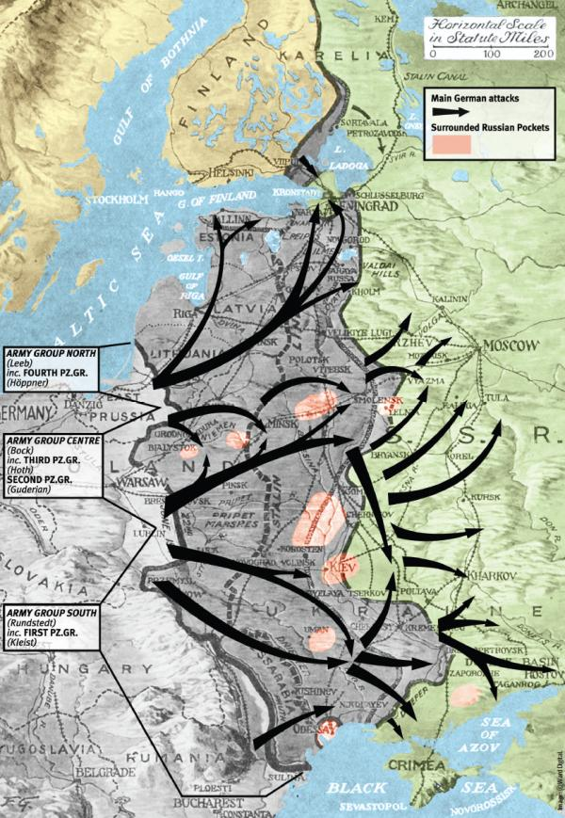
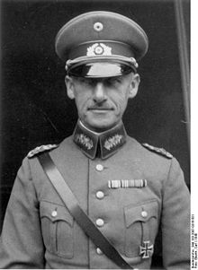
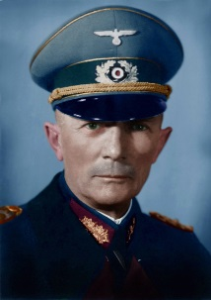
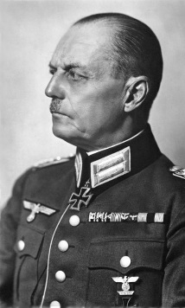
WWII
Operation Barbarossa
June 1941
- Simultaneous &
Successive operations
- Encircle and annihilate
Notes:
Commanders:
Field Marshal Wilhelm von Leeb: Army Group North
Field Marshal Fedor von Bock: Army Group Center
Field Marshal Gerd von Rundstedt: Army Group South
Synopsis from Wikipedia: Operation Barbarossa was the largest military operation in world history in both manpower and casualties. Over the course of the operation, about four million soldiers of the Axis powers invaded the USSR along a 2,900 km (1,800 mi) front. In addition to troops, Barbarossa initially used 600,000 motor vehicles and 625,000 horses. It marked the beginning of the pivotal phase in deciding the victors of the war. The German invasion of the Soviet Union caused a high rate of fatalities: 95 percent of all German Army casualties that occurred from 1941 to 1944, and 65 percent of all Allied military casualties from the entire war. Tactically, the Germans won resounding victories and occupied some of the most important economic areas of the Soviet Union, mainly in Ukraine. Despite these successes, the German offensive stalled on the outskirts of Moscow and was then pushed back by a Soviet counter offensive without having taken the city. The Germans could never again mount a simultaneous offensive along the entire strategic Soviet–German front.

Slide 33
Operational Art
Evolution of Operational Theory/Art
18th Century
  Practice focused on maneuver and sieges—smaller forces.
  Geometry of the battlespace, creation of Divisions by French ~1760.
19th Century
  Napoleonic legacy—pursuit of the decisive battle, est. Corps. Growing size of battlefield/campaigns and armies.
  German School—envelop and annihilate (Franco Prussian War); German General Staff
  US Civil War---large distributed and sequential operations in 1864.
20th Century
  Soviet School—”operational art” and deep operations.
  British School—indirect approach and psychological dislocation. “Shot to the brain.”
20th/21st Century
  American School(s)
    AirLand Battle---and operational level of war, (FM 100-5, 1982)
    Irregular Warfare and hybrid warfare?
Why Operational Art?
Rise of mass armies, industrial warfare
Increased scale, scope, and complexity of warfare
Tactics unable to achieve strategic objectives
Notes:
Background:
This slide summarizes a lot of evolution of military theory. The general intent was to develop an operational theory of war to fit the times and circumstances.
18th C – War of posts. Limited war of maneuver to obviate decisive engagement. Small professional armies; hard to replace manpower (G-burg vs. Brandywine). Levee en Masse.
19th C – Napoleonic: long deliberate approach to a single, decisive battle. German school: Austro-Prussian and Franco-Prussian Wars – no more war of a single point/emergence of operations and campaigns (Clausewitz and Jomini). German development rested upon Prussia’s, then Germany’s, preeminent strategic dilemma of enemies to east and west. This “strategy of the central position” necessitated rapid operations to avoid a two-front war. Having reformed her armies during the Napoleonic Wars, Prussia accomplished rapid victory in 1854, 1866, and 1870.
20th C - British school: Indirect approach / maneuver warfare: avoid defensive stalemate and strategy of attrition (WWI)—Fuller and Liddle Hart
Soviet school: Tukachevsky and strategy of annihilation: “deep operations” and envelopment. The interwar period saw a great deal of effort to digest the lessons of the Great War, specifically to avoid another trench deadlock which characterized the Western Front. This intellectual ferment also took place during a time of severe economic austerity and rapid technological change. The Cold War drove much military theoretical discussion and debate from 1945 to ca. 1990. Arguably, post-Cold-War debate has lacked such focus . . .

Slide 34
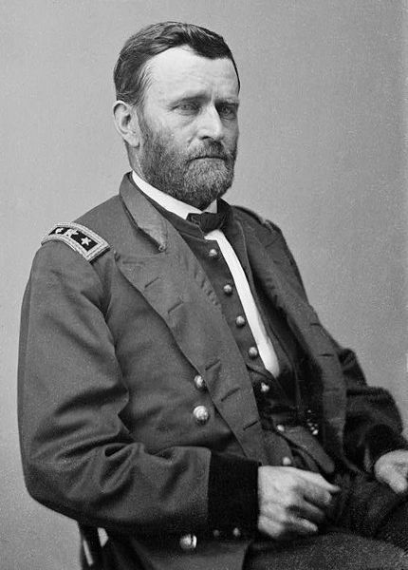
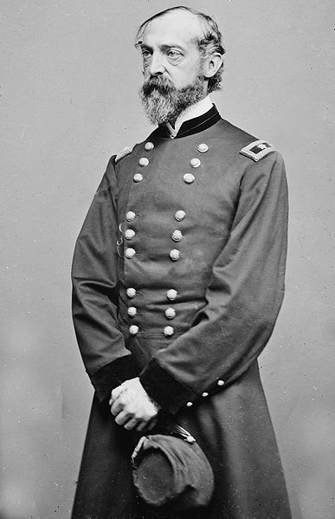
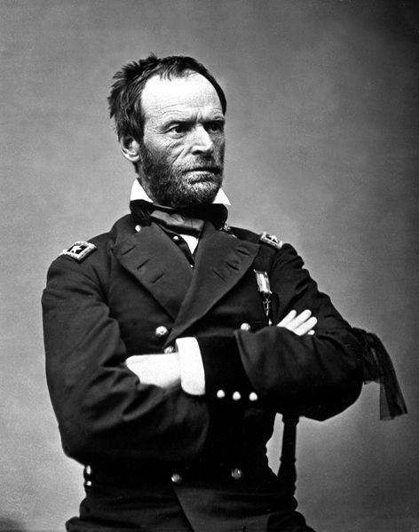
1864 Overland Campaign
To Sherman: "You I propose to move against Johnston's army, to break it up, and to get into the interior of the enemy's country as far as it is possible, inflicting all the damage you can against their war resources."
To Meade: "Lee's army will be your objective point. Wherever Lee goes, there you will go also."
Notes:
- Supports LO: Analyze the concepts of operational art and operational design.
Supporting Readings: Schneider; Elkus; and Kelly & Brennan (suggested readings).
Discussion: This slide may also be in the Mission Command Lesson, but it serves to reinforce the point that Mission Command, Operational Art, and Design are all mutually reinforcing and indeed inextricably intertwined.
Video: Overview of the Overland Campaign (5 min).
NEXT SLIDE: Map of the 1864 Overland Campaign

Slide 35
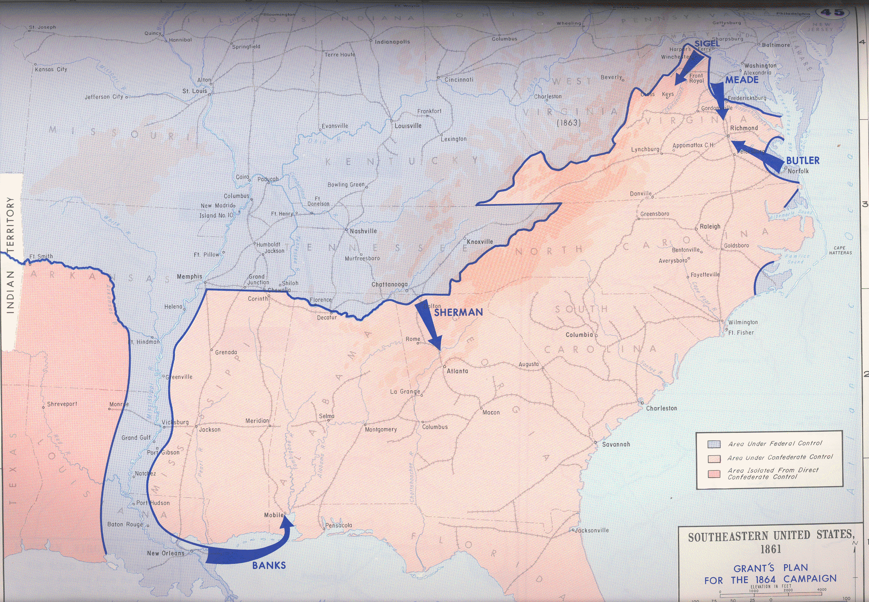
US Civil War, 1864
GEN Grant: Break the Confederates’ strategic, economic,
and psychological capacity for warfare.
Distributed Ops of major forces.
Sequential Ops “ “ “
Rail and telegraph-enabled.
Cooperation with the Navy.
Notes:
U.S. Grant’s Plan: Simultaneous and coordinated advance against the Confederacy starting in May 1864
- Supports LO: Analyze the concepts of operational art and operational design.
Supporting Readings: Schneider; Elkus; and Kelly & Brennan (suggested readings).
Discussion: Here is a sample of U.S. forces in practice. Note how Lt. Gen. Ulysses S. Grant orchestrated the simultaneity of seemingly-disparate operations.
Background:
On March 10, 1864, Lincoln appointed Grant as General in Chief of the Armies of the United States. Grant believed that up to that point, Union armies in different theaters had “acted independently and without concert, like a balky team, no two ever pulling together.” Accordingly, his strategic plan for 1864 called for putting five Union armies into motion simultaneously against the Confederacy. While three smaller armies in peripheral theaters (Nathaniel Banks against Mobile, Franz Sigel in the Shenandoah Valley; and Ben Butler moving toward Richmond via the James River) tied down significant Confederate forces, preventing them from shifting troops from one theater to another, the two main armies, Meade’s Army of the Potomac and William Tecumseh Sherman’s army group at Chattanooga would lock horns respectively with Lee in Virginia and Joe Johnson’s Army of Tennessee on the road to Atlanta. As General in Chief, Grant chose to accompany Meade as he took on Lee. For nearly forty days, the Army of the Potomac and the Army of Northern Virginia were in nearly constant contact—at the Wilderness, Spotsylvania, North Ana, and Cold Harbor. The Virginia Campaign of May-June 1864 reflected Grant’s military philosophy. “The art of war,” he maintained, “is simple enough. Find out where your enemy is. Get at him as soon as you can. Strike him as hard as you can and as often as you can, and keep moving on.” The terrible cost of the Virginia Overland campaign has led some to dismiss Grant as a butcher, but the truth of the matter is far more complex. This campaign demonstrated that Grant, unlike his predecessors, understood what it would take to defeat the Confederacy.
The American Civil War in general, and Grant’s actions in particular, raise the topic of an “American way of war.”
NEXT SLIDE: WW II Pacific Theater Example—USAWC 1934

Slide 36
How do you “design” a “campaign” for acquisition/development?

Slide 37
Operational Art vs. Operational Design
A way to think about them:
  Operational Design provides a framework, methodology, and the environmental understanding that lets operational art thrive. They both help determine the operational approach.

Slide 38
Operational Art and Operational Design
Operational design extends operational art’s vision with a creative methodology that helps commanders and staffs understand the nature of the operational environment, the problem facing them, and possible broad solutions to the problem. Operational design uses various design elements (tools) —such as objective, line of operations, and decisive point,—that help the commander and staff develop and define the broad approach that will guide detailed planning.
Key Requirements of Op Design:
(1) Understand the operation’s context—the strategic guidance (desired national and military end states, objectives, and operational limitations), the nature of the operational environment, and the problem that requires commitment of military capabilities.
(2) Given this context, develop an approach to overcome the problem and set the conditions to achieve objectives that create the desired end state.
(3) During design, resolve differences in perspective with key leaders on the national and military end states, objectives, and the problem;

Slide 39
Operational Art and Operational Design
A Design Methodology for Building a Theater Strategy
Frame the Environment
- describe the current environment
analyze guidance
analyze available DIME power and limitations
- determine the tendency of the environment
- determine our desired theater end state conditions
determine opposing end states conditions
Frame the problem
- identify the differences between desired end state conditions
- find opportunities and tensions
- determine which tensions must be reconciled
- describe concisely the problem set that the theater strategy must solve
- describe the timeframes for solving the problem(s)
Frame a strategic approach
- Determine objectives
- Describe a broad concept to accomplish the objectives
- Identify the decisive points
- Identify the general lines of effort
- Determine the likely 2d/3d order effects of the strategy on the environment
- Find ways to avoid/mitigate the strategic risks of the strategy or note the risks and dialogue with higher
Theater Strategy = Ends, Ways, Means, Risk

Slide 40
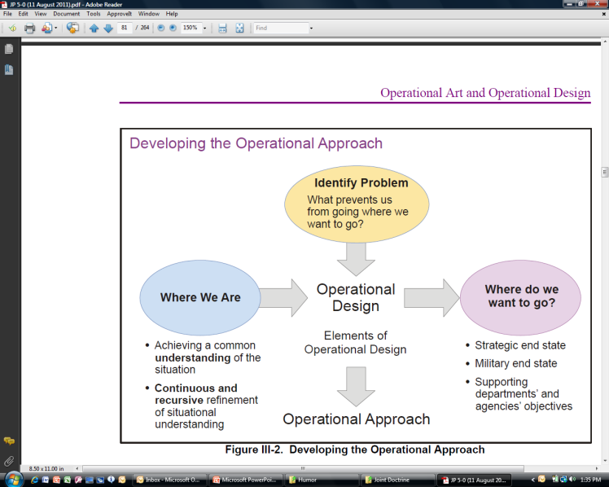
Operational Art and Operational Design
Operational Design (JP 5-0)
Recursive and ongoing dialogue with collaboration higher, lower, with other agencies and MN partners
Applies to military operational complex problems at the theater strategic and operational level (but, design methodology will help at the strategic level as well)
Product is the operational approach; understanding of the environment and problem is the basis for the operational approach

Slide 41
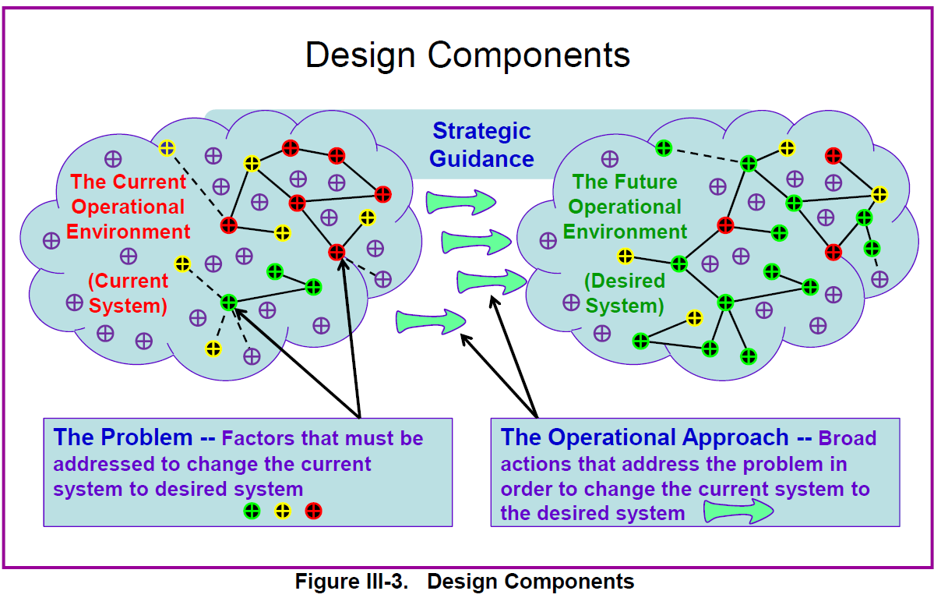
Operational Art and Operational Design
Planner’s Handbook for Operational Design
7 Oct 2011. p. III-11

Slide 42
Elements of Operational Design
Operational Art
DESIGN ELEMENTS
Termination
Military End State
Operational Art
Objectives
Center of Gravity
Arrangement of
O
Decisive Points
Capabilities in Time,
P
Space, and Purpose
E
National Strategic
Direct & Indirect Approach
Linkage of Ends,
J
End State
Ways, and Means
O
R
Systems Perspective
Joint Operation Planning Process
I
A
of the Operational
Course of Action
N
T
Environment
Lines of Operation/Effort
Commander
I
’
s
T
Operational Reach
Intent
O
Forces & Functions
Concept of
N
Anticipation
Operations
S
Culmination
Operational Art
Arranging Operations
Effects
Operational Art
Notes:
A review from last class and visual of where/how the elements may fall in the interplay of design, art, and planning.

Slide 43
Notes:
This is a deeper discussion on several of the elements, with an abbreviated definition of each.
There are four primary considerations for writing a desired effect statement.
(1) Each desired effect should link directly to one or more objectives.
(2) The effect should be measurable.
(3) The statement should not specify ways and means for accomplishment.
(4) The effect should be distinguishable from the objective it supports as a
condition for success, not as another objective or a task.
This chart also represents the important link from tactical through strategic. Everything we do should feed into attaining the higher level’s objective, mission, or end state.

Slide 44
An Example…
Endstate: Regional stability restored with economic and trade conditions restored to pre-conflict levels. Newland no longer threatens region through use of insurgency or state-sponsored terrorism.
Objectives:
  1. Eliminate Newlandian regional aggression.
    Effect: Newland no longer threatens its neighbors through use of conventional/irregular military actions.
      Task 1: Increase SC/SA activities with Oldland and Blueland (neighbors).
      Task 2: Gradually reintegrate Newland into the region (POL-MIL ).
  2. Ensure Oldland’s (key partner) national sovereignty and territorial integrity.
    Effect 1: Oldland’s armed forces and police capable of providing for internal defense against insurgency and criminal activity.
    Effect 2: Territorial integrity maintained.
      Task 1:

Slide 45
The Operational Approach – One Way
Line of Effort A
Effects Set 1
DP1
Obj 1
Obj 2
Obj3
Obj4
Obj5
Obj 6
Effects Set 2
Desired End State
Condition 1
Condition 2
Condition 3
Condition 4
Effects Set 3
Line of Effort B
Effects Set 4
Effects Set 5
Effects Set 6
Line of Effort C
Developed
From -------------------------------------------------------------To
Notes:
Lines of effort/approach—backward planning
The previous class discussed what an operational approach is, this is an example of a way or how to do it using the elements of operational design. Students should be aware this only one way/example of an operational approach. A narrative with or without a map may be just as effective.
Desired End State is derived from Framing the Operational Environment (see chart JP 5-0 p. III-8) –which includes strategic guidance
Condition also = Termination criterion. See “termination” slide w/definition.

Slide 46
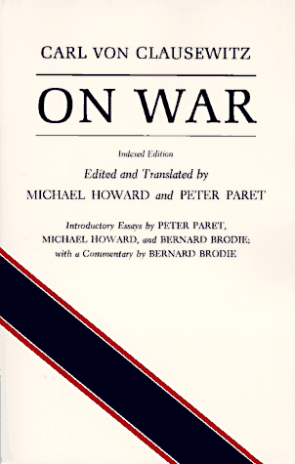
Center of Gravity
The source of power that provides moral or physical strength, freedom of action, or will to act. (JP 5-0)
“… One must keep the dominant characteristics of both belligerents in mind. Out of these characteristics a certain center of gravity develops, the hub of all power and movement, on which everything depends.”
In order to win, we must focus combat power toward a decisive aim….this decisive aim is the enemy’s COG
Notes:
Clausewitz characterizes the COG as the “hub of from which an adversary (him or us) derives his power and that which he is fully dependent upon for success”.
JP 5-0 characterizes it as “ that source of power that provides moral or physical strength, freedom of action and the will to act.”

Slide 47
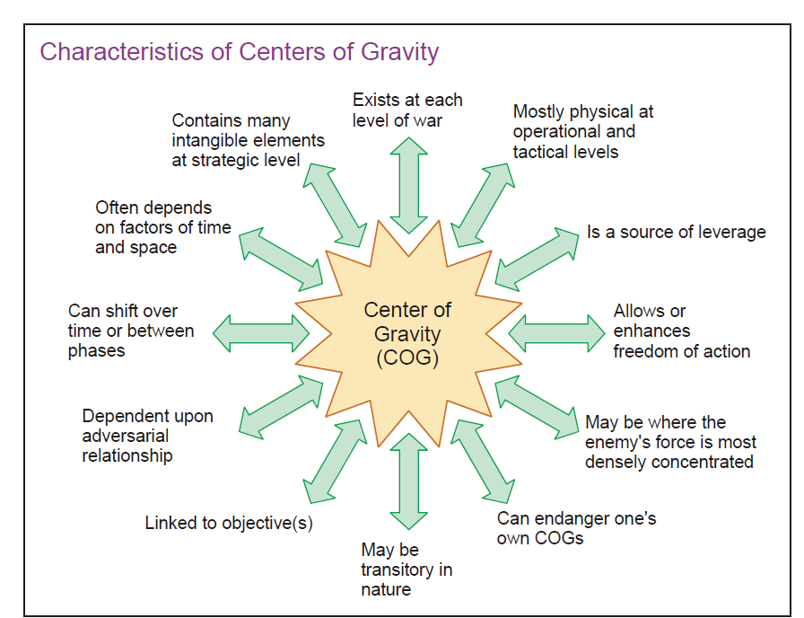
Notes:
Joint doctrine says COG is a product of Framing the Environment yet this chart from the same book (JP 5-0) shows it is linked to objectives—which are usually determined during or after Framing the Problem. Understand this is a contradiction in the doctrine. Identifying the COG(s) while Framing the Environment may taint your analysis/understanding of the problem. Instead, framing the problem should better help identify the COG.

Slide 48
COG Arguments
Linkage to Design:
  Problems (from Design) Objectives CoG analysis DPs
Physical and/or Moral COGs….what is a moral COG?
What of the notion of multiple COGs? Is there a COG at the…..
  Strategic Level
  Operational Level
  Tactical Level??
Historical examples……..
  Germany’s CoG in WWII?
  US in Vietnam?
  Operational CoGs in Desert Storm?
  OIF operational CoGs for phase III (dominate)? Phase IV (stabilize)?
(but some OBJs given by higher orders)
One or more than one at each level?
Do they change by Phase? Why?

Slide 49
An Example of why CoGs Change
Problem/OBJ: how do we prevent China from invading Taiwan? (CoG, CCs, CRs, CVs).
Problem/OBJ: how do we defeat a Chinese
invasion of Taiwan? (CoG, CCs, CRs, CVs)
Notes:
Use dry erase board and see how different the responses are between the CoGs, CCs, CRs, CVs for each problem/OBJ.
Possible COGs:
1st problem: Chinese will to invade.
2nd problem: Enemy forces on Taiwan. CVs might be their Lines of Communication.

Slide 50
COG Analysis
CC
CR
Critical Capability: A means that is considered a crucial enabler for a COG to function as such, and is essential to the accomplishment of the specified or assumed objective(s) JP 5-0
CV
CR
CC
CR
CV
COG
CV
CC
CR
CR
CV
CR
CV
CC
Critical vulnerability: an aspect of a CR which is deficient or vulnerable to direct or indirect attack that will create decisive or significant effects. JP 5-0
CR
CV
CR
CV
Critical Requirement: An essential condition, resource, and means for a critical capability to be fully operational. JP 5-0
Notes:
Discuss CCs, CRs and CVs and make the students come up with examples. There are a varied number of arrows to highlight that a CC may have one or multiple CRs. You will discuss this again in the third hour with the ISIS example.

Slide 51
Elements of Operational Design
Geographic place, specific key event, critical factor, or function that, when acted upon, allows a commander to gain a marked advantage over an adversary or contributes materially to achieving success. (JP3-0)
Key Enemy CVs
Key Adversary CVs
DP
Key Friendly CRs
DP
Linked together, these become the basis for developing action along Lines of Operation or Lines of Effort
Key Neutral CVs or CRs
DP
Key aspects of the Operational Environment
DP
DP
Key tensions between actors goals
DP
DP
Keys to attacking or protecting COGs

Slide 52
Example Decisive Points
Event DPs:
  Sea lanes to ports secured
  Country Y allows staging & basing
  JRSOI of 3 BCTs and fighter wing in Country Z complete
  Enemy 3rd Corps withdraws from Country Z’s territory
  Insurgency attacks Country Z government
  HA to Country Z established
  Rule of law established in country Y
  Fair election held
System DPs:
  Air superiority over Country X achieved
  3rd Corps destroyed
  Country X leader’s bank accounts frozen
  Coalition networks secure
  Intel sharing network among coalition members established
Geographic DPs:
  Major highway crossing impassable to Country X’s armor
  Routes into Country Z from Country X secured
  Seizing Berlin
Getting the labels right
is not the important
part, rather, think about the many dimensions in which DPs can exist.
Notes:
JRSOI: Joint Staging Onward Moving and Integration

Slide 53
Design Techniques
Framing techniques:
  Node and link diagrams using PMESII
  Bullet comments using PMESII
  Dialog and narrative using PMESII
  Combinations of the above

Slide 54
Back-ups and Reference Slides

Slide 55
Elements of Operational Design
Termination
Effective planning cannot occur without a clear understanding of the end state and the conditions that must exist to end military operations. Knowing when to terminate military operations and how to preserve achieved advantages is key to achieving the national strategic end state. To plan effectively for termination, the supported JFC must know how the President and SecDef intend to terminate the joint operation and ensure that its outcomes endure.
EXAMPLES OF TERMINATION CRITERIA (Note the description of condition, not action):
Country X’s borders are secure.
Country Y no longer poses an offensive threat to the countries of the region.
Country X’s national security force is sufficient to repress internal rebellion.
Percentage of US forces have redeployed with sufficient combat power postured in theater to support Country X’s national army.

Slide 56
Elements of Operational Design
Military End State
Military end state is the set of required conditions that defines achievement of all military objectives. It normally represents a point in time and/or circumstances beyond which the President does not require the military instrument of national power as the primary means to achieve remaining national objectives. While it may mirror many of the conditions of the national strategic end state, the military end state typically will be more specific and contain other supporting conditions. These conditions contribute to developing termination criteria, the specified standards approved by the President and/or SecDef that must be met before a joint operation can be concluded.

Slide 57
Elements of Operational Design
Objectives
An objective is a clearly defined, decisive, and attainable goal toward which every military operation should be directed. Once the military end state is understood and termination criteria are established, operational design continues with development of strategic and operational military objectives. Joint operation planning integrates military actions and capabilities with those of other instruments of national power in time, space, and purpose in unified action to achieve the JFC’s objectives. Objectives and their supporting effects provide the basis for identifying tasks to be accomplished.
Objectives prescribe friendly goals. They constitute the aim of military operations and are necessarily linked to national objectives (simply defined as what we want to accomplish). Military objectives are one of the most important considerations in campaign and operational design. They specify what must be accomplished and provide the basis for describing desired effects.

Slide 58
Elements of Operational Design
Effects
An effect is a physical and/or behavioral state of a system that results from an action, a set of actions, or another effect. A desired effect can also be thought of as a condition that can support achieving an associated objective, while an undesired effect is a condition that can inhibit progress toward an objective. In applying unified action, a JFC synchronizes the diplomatic, informational, military, and economic power of the US to affect an adversary’s PMESII systems.

Slide 59
Elements of Operational Design
Center of Gravity
A COG is a source of power that provides moral or physical strength, freedom of action, or will to act. It is what Clausewitz called “the hub of all power and movement, on which everything depends…the point at which all our energies should be directed.” An objective is always linked to a COG. There may also be different COGs at different levels, but they should be nested.
COGs exist in an adversarial context involving a clash of moral wills and/or physical strengths. They are formed out of the relationships between adversaries, and they do not exist in a strategic or operational vacuum. COGs are framed by each party’s view of the threats in the operational environment and the requirements to develop/maintain power and strength relative to their need to be effective in accomplishing their objectives.

Slide 60
Elements of Operational Design
Decisive Points
A decisive point is a geographic place, specific key event, critical factor, or function that, when acted upon, allows a commander to gain a marked advantage over an adversary or contributes materially to achieving success (e.g., creating a desired effect, achieving an objective). Decisive points can greatly influence the outcome of an action.
The most important decisive points can be determined from analysis of critical factors. Understanding the relationship between a COG’s critical capabilities, requirements, and vulnerabilities can illuminate direct and indirect approaches to the COG. It is likely that most of these critical factors will be decisive points, which should then be further addressed in the planning process.

Slide 61
Elements of Operational Design
Lines of Operation/Effort
A Line Of Operations defines the interior or exterior orientation of the force in relation to the enemy or that connects actions on nodes and/or decisive points related in time and space to an objective(s). LOOs describe and connect a series of decisive actions that lead to control of a geographic or force-oriented objective.
A Line Of Effort links multiple tasks and missions using the logic of purpose—cause and effect—to focus efforts toward establishing operational and strategic conditions. In operations involving many nonmilitary factors, lines of effort may be the only way to link tasks, effects, conditions, and the desired end state. Lines of effort are often essential to helping commanders visualize how military capabilities can support the other instruments of national power.

Slide 62
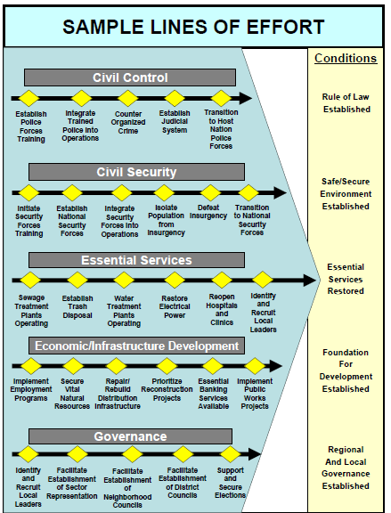
Elements of Operational Design

Slide 63
Elements of Operational Design
Direct and Indirect Approach
The approach is the manner in which a commander contends with a COG.
  A direct approach attacks the enemy’s COG or principal strength by applying combat power directly against it.
  An indirect approach attacks the enemy’s COG by applying combat power against a series of decisive points that lead to the defeat of the COG while avoiding enemy strength.

Slide 64
Elements of Operational Design
Anticipation
Anticipation is key to effective planning. JFCs must consider what might happen and look for the signs that may bring the possible event to pass. During execution, JFCs should remain alert for the unexpected and for opportunities to exploit the situation. They continually gather information by personally observing and communicating with higher headquarters, subordinates, partner nations, and other organizations in the OA. JFCs may avoid surprise by gaining and maintaining the initiative at all levels of command and throughout the OA, thus forcing the adversary to react rather than initiate, and by thoroughly and continuously wargaming to identify probable adversary reactions to joint force actions.

Slide 65
Elements of Operational Design
Operational Reach
Operational reach is the distance and duration across which a joint force can successfully employ military capabilities. Although reach may be constrained or limited by the geography in and around the OA, it may be extended through forward positioning of capabilities and resources, increasing the range and effectiveness of weapon systems, leveraging HNS and contract support (system, external, theater) and maximizing the throughput efficiency of the distribution architecture.

Slide 66
Elements of Operational Design
Culmination
Culmination is that point in time and/or space at which the operation can no longer maintain momentum.
  In the offense, the culminating point is the point at which effectively continuing the attack is no longer possible and the force must consider reverting to a defensive posture or attempting an operational pause.
  A defender reaches culmination when the defending force no longer has the capability to go on the counteroffensive or defend successfully. Success in the defense is to draw the attacker to offensive culmination, then conduct an offensive to expedite the adversary’s defensive culmination.

Slide 67
Elements of Operational Design
Arranging Operations
Commanders must determine the best arrangement of joint force and component operations to conduct the assigned tasks and joint force mission. This arrangement often will be a combination of simultaneous and sequential operations to reach the end state conditions with the least cost in personnel and other resources. Commanders consider a variety of factors when determining this arrangement, including geography of the OA, available strategic lift, changes in command structure, force protection, distribution and sustainment capabilities, adversary reinforcement capabilities, and public opinion. Thinking about the best arrangement helps determine the tempo of activities in time, space, and purpose. Planners should consider factors such as simultaneity, depth, timing, and tempo when arranging operations.
Notes:
(a) Simultaneity refers to the simultaneous application of military and nonmilitary power against the enemy’s key capabilities and sources of strength. Simultaneity in joint force operations contributes directly to an enemy’s collapse by placing more demands on enemy forces and functions than can be handled. This does not mean that all elements of the joint force are employed with equal priority or that even all elements of the joint force will be employed. It refers specifically to the concept of attacking appropriate enemy forces and functions throughout the OA (across the physical domains and the information environment [which includes cyberspace]) in such a manner as to cause failure of their moral and physical cohesion.
(b) Simultaneity also refers to the concurrent conduct of operations at the tactical, operational, and strategic levels. Tactical commanders fight engagements and battles, understanding their relevance to the contingency plan. JFCs set the conditions for battles within a major operation or campaign to achieve military strategic and operational objectives. GCCs integrate theater strategy and operational art. At the same time, they remain acutely aware of the impact of tactical events. Because of the inherent interrelationships between the various levels of war, commanders cannot be concerned only with events at their respective echelon, but also must understand how their actions contribute to the military end state.
(c) The evolution of warfare and advances in technology have continuously expanded the depth of operations. US joint forces can rapidly maneuver over great distances and strike with precision. Joint force operations should be conducted across the full breadth and depth of the OA, creating competing and simultaneous demands on adversary commanders and resources. The concept of depth seeks to overwhelm the enemy throughout the OA, creating competing and simultaneous demands on enemy commanders and resources and contributing to the enemy’s speedy defeat. Depth applies to time as well as geography. Operations extended in depth shape future conditions and can disrupt an opponent’s decision cycle. Strategic attack, interdiction, and some IO are examples of the applications of depth in joint operations. Operations in depth contribute to protection of the force by destroying adversary potential before its capabilities can be realized or employed.
(d) The joint force should conduct operations at a tempo and point in time that best exploits friendly capabilities and inhibits the adversary. With proper timing, JFCs can dominate the action, remain unpredictable, and operate beyond the adversary’s ability to react.
(e) The tempo of warfare has increased over time as technological advancements and innovative doctrines have been applied to military requirements. While in many situations JFCs may elect to maintain an operational tempo that stretches the capabilities of both friendly and adversary forces, on other occasions JFCs may elect to conduct operations at a reduced pace. During selected phases of a campaign, JFCs could reduce the pace of operations, frustrating adversary commanders while buying time to build a decisive force or tend to other priorities in the OA such as relief to displaced persons. During other phases, JFCs could conduct high-tempo operations designed specifically to overwhelm adversary defensive capabilities. Assuring strategic mobility preserves the JFC’s ability to control tempo by allowing freedom of theater access.
(2) Several tools are available to planners to assist with arranging operations. Phases, branches and sequels, operational pauses, and the development of a TPFDD all improve the ability of the planner to arrange, manage, and execute complex operations.
(a)Phases. Phasing is a way to view and conduct a complex joint operation in manageable parts. The main purpose of phasing is to integrate and synchronize related activities, thereby enhancing flexibility and unity of effort during execution. Reaching the end state often requires arranging a major operation or campaign in several phases. Phases in a contingency plan are sequential, but during execution there will often be some simultaneous and overlapping execution of the activities within the phases. In a campaign, each phase can represent a single major operation, while in a major operation a phase normally consists of several subordinate operations or a series of related activities. See
Section C, “Phasing,” for a more detailed discussion.
(b) Branches and Sequels. Many contingency plans require adjustment beyond the initial stages of the operation. Consequently, JFCs build flexibility into their plans by developing branches and sequels to preserve freedom of action in rapidly changing conditions. They are primarily used for changing deployments or direction of movement and accepting or declining combat. Branches and sequels directly relate to the phasing construct.
1. Branches provide a range of options often built into the basic plan. Branches add flexibility to plans by anticipating situations that could alter the basic plan. Such situations could be a result of adversary action, availability of friendly capabilities or resources, or even a change in the weather or season within the OA.
2. Sequels anticipate and plan for subsequent operations based on the possible outcomes of the current operation—victory, defeat, or stalemate. For every action or major operation that does not accomplish a strategic or operational objective, there should be a sequel for each possible outcome, such as win, lose, draw, or win big.

Slide 68
Elements of Operational Design
Forces and Functions
Commanders and planners can design campaigns and operations that focus on defeating either adversary forces, functions, or a combination of both. Typically, JFCs structure operations to attack both adversary forces and functions concurrently to create the greatest possible friction between friendly and adversary forces and capabilities.

