Slide 1
Welcome to APG Senior Leadership Cohort
“At the end of the day it's not about what you have or even what you've accomplished…it's about who you've lifted up and who you've made better. It's about what you've given back.”
-Denzel Washington

Slide 2
Session Agenda – Day One
Session Opening
Introductions
Leadership Frames
Assessing Personal Style using DiSC
Experiential Activity Towers Building
Leadership Reflections

Slide 3
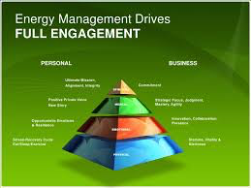
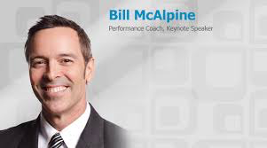
Session Agenda – Day Two
Personal Energy Management
Bill McAlpine

Slide 4
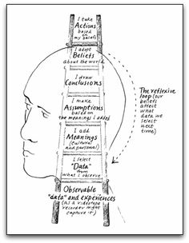
Session Agenda – Day Three
Communication Skills – Active Listening
The Ladder of Inference & Mental Models
Leadership Styles
Key Messages from your reading
Program Requirements:
PEM Selection
CBP Selection Process Set up

Slide 5
Leadership Competency Model: 5 ECQs and Fundamental Competencies
Leading
Leading
Results
Business
Building
Change
People
Driven
Acumen
Coalitions
Creativity
&
Conflict
Accountability
Financial
Partnering
Innovation
Management
Customer Service
Management
Political
External
Leveraging
Decisiveness
Human Capital
Savvy
Awareness
Diversity
Entrepreneurship
Management
Influencing/
Flexibility
Developing
Problem Solving
Technology
Negotiating
Resilience
Others
Technical
Management
Strategic
Team Building
Credibility
Thinking
Vision
Fundamentals
Interpersonal Skills Oral Communication Continual Learning
Written Communication Integrity/Honesty
Public Service Motivation

Slide 6
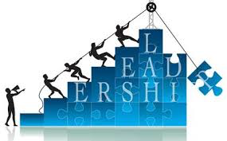
Leaders Lead Content and Context
Leading when you know … content
Leading when you don’t know … context
→ Adaptive Leadership

Slide 7
Leaders Have Multiple Agendas
Delivering Today’s Results
Aggressive Continuous Improvement
Building the Future
Must do all … both/and
→ Creates Dilemmas & Tension

Slide 8
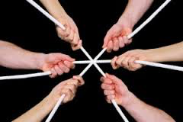
Leaders Hold the Tension of Dilemma’s
Recognize dilemmas – both/and
Respect them – tension is normal – they don’t go away
Reconcile them – find workable ways forward & continue to manage them

Slide 9
Leaders Create Engagement
Create strategy
Align behavior with strategy
Ensure emotional subtext creates productive behavior
Leaders as Storytellers
- Logos … Ethos … Pathos

Slide 10
Leaders Create and Shape Culture
Leaders create a context where people can do their best
Organizations are what people do – not the structure and processes
People tell stories about leaders – what’s the story you want them to tell about you?

Slide 11
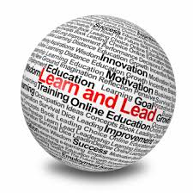
Leaders Continuously Learn
You don’t have to be ill to get better
Practiced behavior becomes part of your identity over time – keep practicing
People are more likely to act their way into a new way of thinking than think their way into a new way of acting

Slide 12
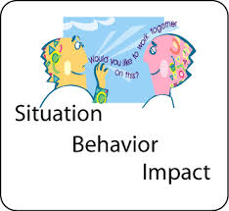
Positive Feedback
Provide feedback to your peers during this session
NOTICE the behavior of others
Get feedback on your impact
Practice using the SBI feedback Model

Slide 13
Balancing Feedback
Constructive
Positive

Slide 14
What the Research Says
96% of people say they like hearing that they have done a good job
98% say that if you tell them when they have done good job they will work harder for you
50% of Managers say they only give praise when someone has done an exceptional job

Slide 15
Personal Profile
Understanding behavioral style using DiSC Work of Leaders

Slide 16
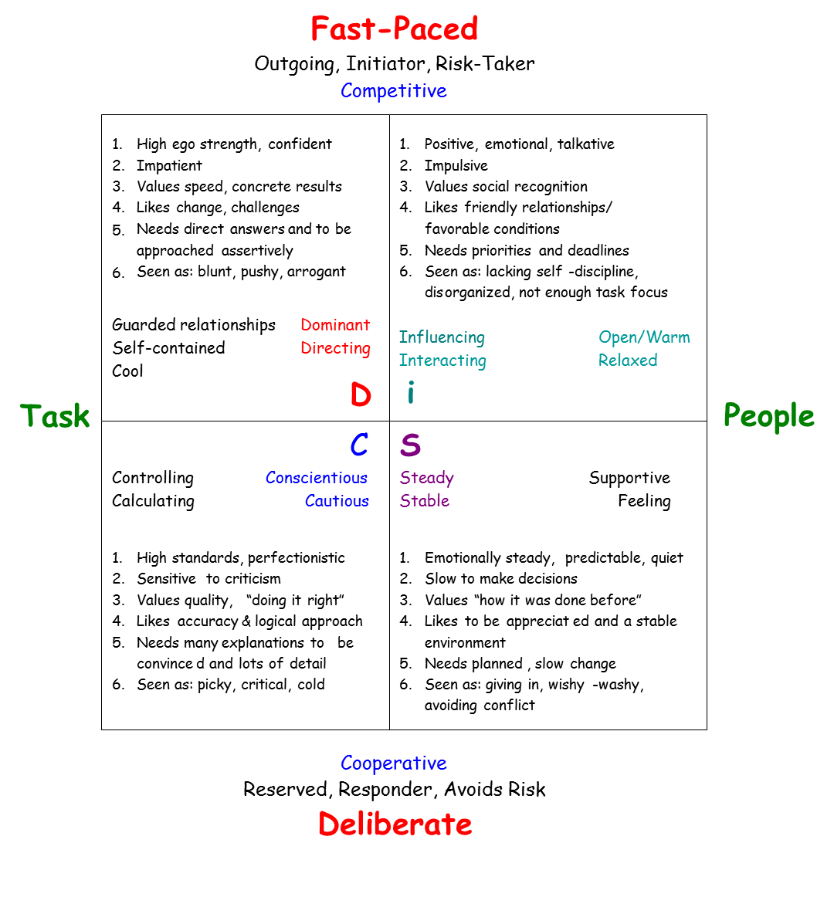

Slide 17
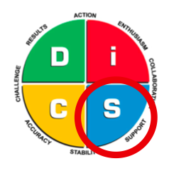
Characteristics of S’s
Perform in a consistent and steady manner
Patient
Help others
Show loyalty
Good listeners
Develop specialized skills
Create a stable harmonious environment

Slide 18
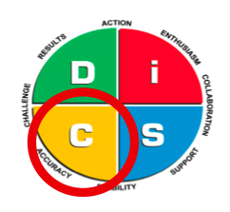
Characteristics of C’s
Adhere it standards and directives
Focus on details
Think analytically
Check for accuracy
Analyze performance critically
Diplomatic with people
Use subtle or indirect approaches to conflict
Use a systematic approach to situations

Slide 19
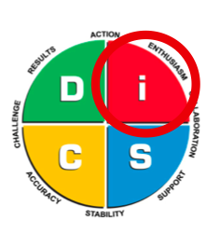
Characteristics of I’s
Connect with people
Make a favorable impression
Articulate
Create a motivating environment
Generate enthusiasm
View people and situations with optimism
Participate in groups

Slide 20
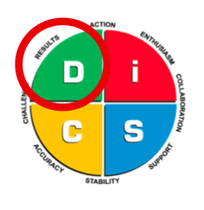
Characteristics of D’s
Focus on immediate results
Take and or cause action
Accept challenges
Make quick decision
Question the status quo
Take authority
Solve problems and manage trouble

Slide 21
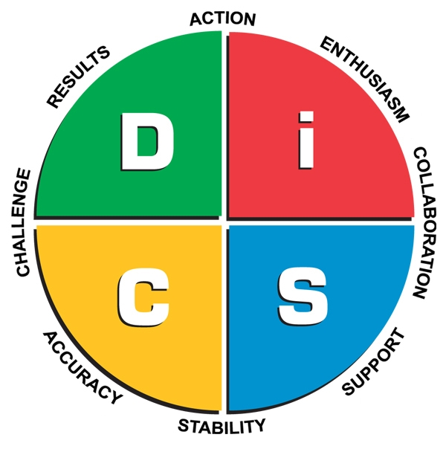
DISC MODEL

Slide 22
Characteristics of D’s
Driving
Decisive
Inquisitive
Forceful
Demanding
Quick
Adventurous
Competitive
Strong-Willed
Purposeful

Slide 23
Characteristics of I’s
Persuasive
Enthusiastic
Outgoing
Dynamic
Sociable
Demonstrative
Self-Advancing
Friendly
Charming
Influential

Slide 24
Characteristics of S’s
Calming
Caring
Encouraging
Patient
Sharing
Relaxed
Amiable
Stable
Deliberate
Loyal

Slide 25
Characteristics of C’s
Deliberate
Logical
Accurate
Precise
Analytical
Careful
Controlled
Stable
Diplomatic
Cautious

Slide 26
DiSC Work of Leaders
Crafting a VISION
Exploration
Boldness
Testing Assumptions

Slide 27
DiSC Work of Leaders
Building ALIGNMENT around a Vision
Clarity
Dialogue
Inspiration

Slide 28
DiSC Work of Leaders
Bringing it to life by championing EXECUTION
Momentum
Structure
Feedback

Slide 29
References
The Universal Language of DiSC, A Reference Manual, Training International, Ltd. 1993
The Four Dimensional Manager, DiSC Strategies for Managing Different People in the Best Ways, Julie Shaw and Allison Brown Cerier, 2002
The Center for International Change, Mount Prospect, Ill. Internalchange.com

Slide 30
Welcome to day three
Senior Leadership Cohort

Slide 31
Clock Partner Activity - Reflections
Share with your partner
What is the old story you are telling yourself?
What does the new story need to sound like?
What is your ULTIMATE MISSION?
Based on your ULTIMATE MISSION what should your FIRST TRAINING mission be? (Physical, Spiritual, Mental, Emotional)
Why would you want to do any of this anyway? For the sake of what (Emotional Anchor)

Slide 32
PEM Reflection Papers
Mission 1 – May 1- July 31
Paper Due First Week August
Mission 2 – Aug 1 – October 31
Paper Due First Week of November
Mission 3 – November 1 – January 31
Paper Due First Week of February

Slide 33
Communication
“Conversation in America is a sport in which the first person to draw breath is declared…. The Listener”

Slide 34
Communication

Slide 35
Communication

Slide 36
Communication
Listening
Why is it so challenging?

Slide 37
The Four Types Of Listening
Active
The Active Listener gives full attention to listening when others are talking and focuses on what is being said. This person expends a lot of energy participating in the speaking-listening exchange evidenced by an alert posture, asking questions for clarity and curiosity, summarizing for accuracy and interpretation of the speaker’s message.
45-50
Involved
The Involved Listener give most of his or her attention to the speaker’s words and intentions. This person reflects on the message to a degree and participates in the speaking-listening exchange. The involved listener practices some direct eye contact and may have alert posture and stance, although this may be intermittent.
38-44
Passive
The Passive Listener receives information as though being talked to rather than as being an equal partner in the speaking-listening exchange. While assuming that the responsibility for the success of the communication is the speaker’s, this listener is usually attentive, although attention may be faked at times. The passive listener seldom expends any noticeable energy in receiving and interpreting messages.
28-37
Detached
The Detached Listener withdraws from the speaking-listening exchange and becomes the object of the speaker’s message rather than its receiver. The detached listener is usually inattentive, disinterested, and may be restless, bored, or easily distracted. This persons noticeable lack of enthusiasm may be marked by slumped or very relaxed posture and avoidance of direct eye contact.
0-27

Slide 38
Four Types of Listening
Active: 45 - 50
Involved 38 - 44
Passive 28 -37
Detached 0 - 27

Slide 39
Active Listening
What are ways to be a more attentive listener?

Slide 40
Active Listening
Do:
Paraphrase and repeat back what you hear
Eye contact
Capture content and emotion of the message
Check your body language
Ask connected questions
Summarize/clarify
Be careful of:
“Me tooing”
Too much praising
Interruptions
Multi-tasking while listening
Asking questions that are “your agenda” not theirs
“Reloading”

Slide 41
Perceptions
“All our knowledge has its origins in perceptions.”
– Leonardo da Vinci

Slide 42
Parent Teacher Conference
What are the various conclusions you find from the participants at your table?
What is the data that support each conclusion?
No discussion or arguments. Just make note of the different conclusions.

Slide 43
Ladder of Inference
We’re pressed for time so we’ll be jumping right to conclusions

Slide 44
Ladder of Inference
Take Action
Adopt Beliefs
Draw
Conclusions
Make Assumptions
Add Meaning
Select Data
Data
Reflexive
Loop

Slide 45
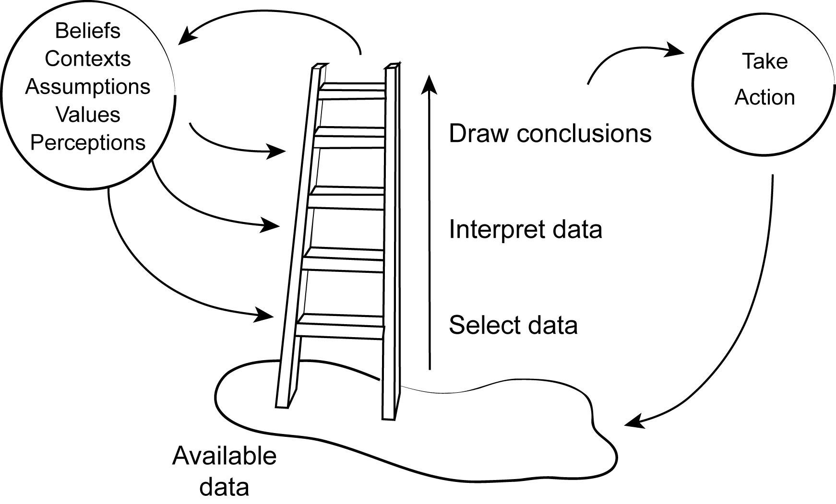
Ladder of Inference
We are so skilled at thinking that we jump up the ladder without knowing it
We tacitly register some data and ignore other data.
We impose our own interpretations on this data and draw conclusions from them.

Slide 46
Mental Models
Deeply held internal images of how the world works that limit us to familiar ways of thinking and acting
New insights fail to get put into practice and that limits us to familiar ways of thinking and acting.
Why two people can observe the same event and describe it differently; they are paying attention to different details.
The discipline of mental models continually surfaces, tests, improves and expands our internal pictures of how the world works
Mental models are the assumptions & stories which we carry in our minds of ourselves, other people, institutions, & every aspect of the world.
. .

Slide 47
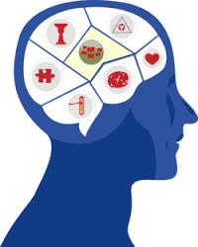
Men
Mental Models Examined
The skills needed to examine our mental models
Reflection
The slowing down of our thinking processes to become aware of how we form our own mental models
Inquiry
Conversations where we share our own thinking & through listening & questioning develop knowledge about each other’s thinking or “mental models”

Slide 48
Advocacy and Inquiry
Telling
Idea
Generation
High
Advocacy
Observing
Asking
Low
Low
High
Inquiry

Slide 49
Men
Locus of Control
Locus of Control
How a person perceives control over their situation.
Internal LOC people view themselves as having control over their life and their response to life.
Goal focused; obstacles can be overcome or worked
Powerful actor; sense of control
Adaptive to change
They talk about . . . Things they can control & What they can do and will do
External LOC blame fate and forces such as destiny or society for controlling their lives and their response to life.
Excuse focus; reasons why obstacles are insurmountable
Passive acceptance of external events
Powerless pawn; lacking sense of control
They talk about . . . What’s wrong with other people, places and things and how it affects them and Things they cannot control

Slide 50
Language and Perception
Internal LOC Language
Let’s start a new habit
Let’s look at more alternatives
I can choose another approach
I can control my own feelings
I can deliver the results
I’ll get input from diverse sources
I will choose my response
I choose, I prefer, I can
External LOC Language
I don’t have time
There’s nothing I can do
That’s just the way I am
He makes me so mad
They won’t give me resources
We’re different
I have to do that
I can’t, I must, if only
It is about how you “frame” it.
When trying to change any part of your life, the quality of internal dialogue is the key aspect to fast and effective change.

Slide 51
Men
Action Science Defined
A strategy for increasing the skills and confidence of individuals in groups to create any kind of organization and to foster long-term individual and group effectiveness.
Increase professional effectiveness = Goal
Problem Types
The action science model focuses primarily on identifying and resolving difficult, complex, real-life problems critical to organizations and society
Learning Defined
Learning occurs when individuals in groups detect and correct gaps between descriptive claims and practical outcomes (intentions and actual results, thoughts and actions, theories and practices.)

Slide 52
Action Science Learning Organization
Governing Variables
Action Strategy
Consequences
Double loop learning
Single loop learning
Human actions are designed to achieve intended consequences and governed by a set of environment variables.
Single loop learning = achieve the intended consequences and suppress conflict about the governing variables (e.g. beliefs, values, etc.)
Double loop learning = achieve the intended consequences AND openly inquire about conflict to possibly transform the governing variables.
Source: Chris Argyris
Notes:
Human actions are designed to achieve intended consequences and governed by a set of environment variables.
When actions are designed to achieve the intended consequences and to suppress conflict about the governing variables, a single loop learning cycle usually ensues.
Actions taken to achieve the intended consequences AND openly inquire about conflict and to possibly transform the governing variables, both single loop and double loop learning cycles usually ensue.
Action Science learning concepts apply not only to personal behaviors but also to organizational behaviors in his models.

Slide 53
Men
Value of Action Science to You
Shared learning throughout various levels of the organization
Greater self-awareness and self-confidence due to new insights and feedback
Ability to ask better questions and be more reflective
Improved communications and teamwork

Slide 54
Spiral of Experience
Action
What did you do? What did your team and organization do?
Experience
Experience
Observation
What happened?
Results
What was the Impact on others, the team and on the organization?
What did you learn?
Reflection
How do you look at it now?
How do you feel about it now?
Experience

Slide 55
Men
Leadership Styles
Results Oriented Styles
Relationship Oriented Styles
Coercive
Pacesetter
Authoritative
Democratic
Affiliative
Coaching

Slide 56
Men
Cohort News
May session – Assessment Center (info on Doc Shelf)
360 Launch – May 5th – Send to raters, complete self assessment
Complete Values Based Leadership Reflections (on Doc Shelf)
PEM Mission 1 – Starts May 5th

